Slide 1

April 2026
LIBOR Legal Update
Patrick Fife, LIBOR General Counsel

Slide 2

LIBOR Is Your Reliable Source for Staying Updated on Legal Changes & Risks
Thursday LIBOR Email -- Free Weekly Legal Tips
Webinars
Broker Portal with Monthly Newsletter and Resource Deck
Broker Quarterly Risk Reduction Webinar Wednesday, June 10. 2026 @ LIBOR Education Conference
LIBOR Events
Free Monthly LIBOR Legal Update CE Class

Slide 3
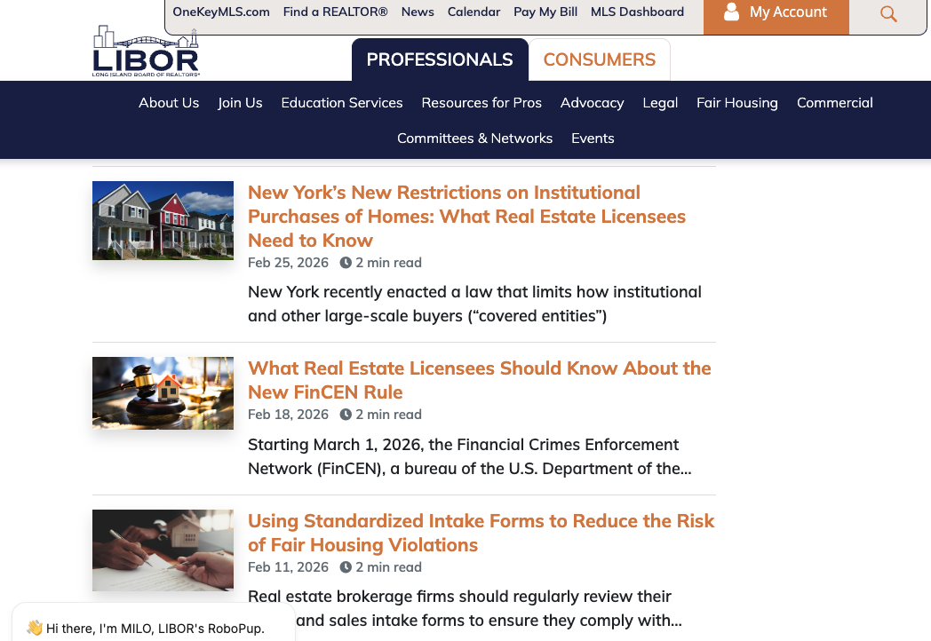
Resources & Education
LIBOR’s Website
LIRealtor.com

Slide 4

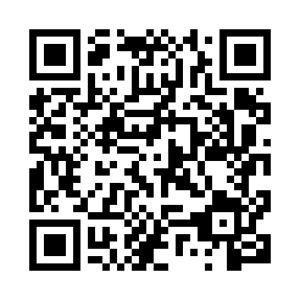
LIBOR 2026 Education Conference
liboredconference.com

Slide 5
LIRealtor.com
Access to Legal Tips
Documents on Demand with Required Disclosures & Notices
Dispute Resolution Center
Educational Materials for You and Your Clients

Slide 6
LIBOR Legal Support Center
LIBOR's Legal Support Center offers members exclusive access to a qualified attorney who can provide information on real estate matters. It is available from 9 a.m. to 5 p.m., Monday through Friday, excluding holidays.
To access, dial 631-661-4800 x335.
Notes:
Other resources from NYSAR and NAR and NYSDOS covered in handout

Slide 7

Some Recent Questions to the Legal Support Center

Slide 8
Can a Listing Agent Require Buyers to Use a Particular Lender?
Seller‑directed lender preferences are generally permitted in New York if they truly originate with the seller and are applied uniformly and lawfully to all buyers.
Sellers may weigh financing strength, including lender choice, when deciding which offer to accept—but the decision must remain non‑discriminatory.
Listing agents must never impose or suggest lender requirements themselves; doing so raises issues under New York license law and the REALTOR® Code of Ethics.
All offers must be presented, even if they do not meet a seller’s stated lender preference.
Listing broker should never be screening or withholding offers.
The key distinction: sellers choose among offers; listing agents present all offers and advise—they do not act as gatekeepers.

Slide 9
How Can I Advertise My Role as a Buyer’s Agent?
Transparency: New York law and REALTOR® Article 12 require advertising to be truthful, accurate, and clear about whom you represented in the transaction.
State your role explicitly: (e.g., “Represented the buyer,” “Buyer’s agent”); avoid standalone phrases like “Just Sold” that could imply listing‑side representation.
Do not imply listing authority or services you did not provide: Ads suggesting listing‑side involvement when you represented only the buyer may be misleading and subject to discipline.
Always present a “true picture” in advertising: No exaggeration, misrepresentation, or use of others’ content in a way that creates a false impression of your role.
MLS photo caution: Buyer’s agents may not use MLS or listing photos without written permission from the listing broker; unauthorized use can trigger MLS, copyright, and disciplinary issues.

Slide 10

How Do I Properly Advertise Myself as a “Licensed REALTOR®”?
Calling yourself a “Licensed REALTOR®” would not be proper under New York law.
All real estate advertising must contain your licensed title (i.e. “real estate salesperson” “real estate broker”).
Review the NY State Real Estate Advertising Checklist for all of the requirements related to real estate advertising.
As a LIBOR member, you can include the REALTOR® mark in your advertising to identify yourself as a REALTOR®.
NAR strictly prohibits combining the REALTOR® marks with geographic or location‑based descriptors, except for local or state REALTOR® associations in official contexts.

Slide 11
What Should I Do if I Learn My Agent Stole Funds?
As a broker, you should terminate the salesperson.
Report the alleged theft to:
  Local law enforcement;
  Your E&O carrier; and
  New York State Department of State.
Notes:
Not required to compensate – but required to cooperate

Slide 12

Can a Landlord’s Agent on a NYC Rental Split Commission Paid to Tenant’s Agent?
No. Under New York City’s FARE Act, a listing broker may not receive any portion of a commission that is paid by the tenant, even indirectly through “sharing” with the tenant’s broker.
FARE Act requires the party who hires a broker is the party who must pay that broker.
If the landlord hires the broker (including a listing broker or any broker who publishes the listing), the landlord must pay all compensation connected to that brokerage role.
Notes:
If the tenant independently hires a broker, the tenant may lawfully pay only that broker.

Slide 13

Do Commercial Listings Require the Same Disclosure Forms?
Fair Housing & Anti‑Discrimination Disclosure is REQUIRED at first substantive contact for all real property, including commercial properties, vacant land, and new construction.
Statutory Agency Disclosure Form is NOT required for commercial transactions.
Brokers must still clearly disclose agency relationships, but this can be done through engagement letters, brokerage agreements, or contract language. Use of the statutory form is not mandated.
A broker may choose to use the statutory agency form voluntarily in a commercial deal, but it is not legally required
Notes:
Risk being an invalid listing . No estate – you want Letters of Administration. Be careful with trusts…matrimonial…settlement agreements…corporate owned properties.

Slide 14
MLS Rule Changes and Ethical Obligations When Presenting Offers
Notes:
Hi everyone, I’m Patrick Fife, LIBOR's General Counsel. I want to give you a quick update on recent MLS rule changes that affect offer presentation — and what your obligations are moving forward.

Slide 15
Recent MLS Rule Change
OneKey MLS no longer mandates offer-acknowledgment process with specific time periods.
No longer a rule requiring seller to sign a specific MLS Offer Acknowledgement Form or the listing broker to provide a sworn declaration that an offer was presented
No longer a rule allowing cooperating brokers to participate in the presentation of an offer.
Notes:
OneKey® MLS recently removed former MLS Rules 405 and 406.
These rules used to govern how listing brokers documented offer presentation and whether cooperating brokers could participate in the presentation process.
The MLS no longer mandates an offer-acknowledgment process with specific time periods and no longer requires the MLS Offer Acknowledgment Form.

Slide 16
What Has NOT Changed
Members still have legal and ethical obligations under REALTOR® Code of Ethics.
Listing Broker must present all offers as quickly as possible (SOP 1-6).
Must continue presenting offers until closing unless waived in writing (SOP 1-7).
Must respond to written requests for confirmation as soon as practical.
Maintain fiduciary duties: loyalty, disclosure, obedience, reasonable care.
Notes:
Even though the MLS rules were removed, your legal and ethical duties remain the same.
Under the REALTOR® Code of Ethics:
Standard of Practice 1‑6 still requires you to present all offers as quickly as possible.
Standard of Practice 1‑7 still requires that you continue presenting offers until closing, unless the seller has waived that obligation in writing.
And when another broker sends a written request for confirmation, you must respond as soon as practical with either:
Written affirmation that you presented the offer, or
Written notice that the seller waived presentation in writing.
Your fiduciary duties — loyalty, disclosure, obedience, and reasonable care — remain fully in place.

Slide 17
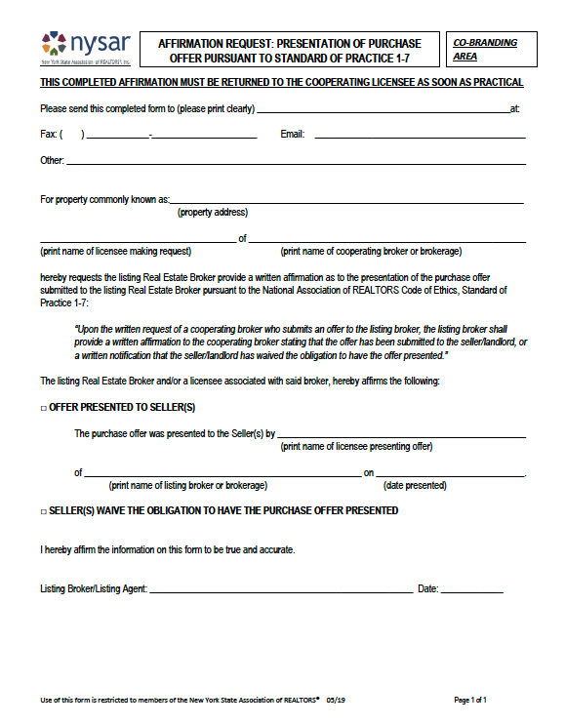
NYSAR Affirmation Request: Presentation of Purchase Offer Pursuant to Standard of Practice 1-7
Cooperating broker can use form to request listing broker’s written confirmation of offer presentation.
Listing broker must check off whether offer presented OR seller waived obligation.
Only select waiver of obligation if you possess written seller authorization.
Notes:
Although the MLS no longer mandates use of its own offer acnowledgemt form, cooperating brokers may still request written confirmation.
For that purpose, OneKey® is making available NYSAR’s Affirmation Request: Presentation of Purchase Offer, which is designed specifically to meet the requirements of Standard of Practice 1‑7.
If you receive this form as the listing broker, you must return it and check one of two boxes:
The offer was presented, or
The seller waived the obligation — but only select waiver if you have a written, signed seller waiver.
This form is optional, but it offers a sound way to ask for and provide confirmation that an offer was presented.

Slide 18
Complaint Resolution Process
The MLS no longer hears or processes complaints regarding offer presentation.
If an offer presentation issue arises, members may contact LIBOR’s Professional Standards Department to:
  Seek Ombudsman assistance through LIBOR.
  File an Ethics Complaint.
Notes:
The MLS Will not longer hear or process complaints regarding offer presentation.
If an offer presentation issue arises, you may contact LIBOR’s Professional Standards Department to:
Seek Ombudsman assistance
File an Ethics Complaint

Slide 19
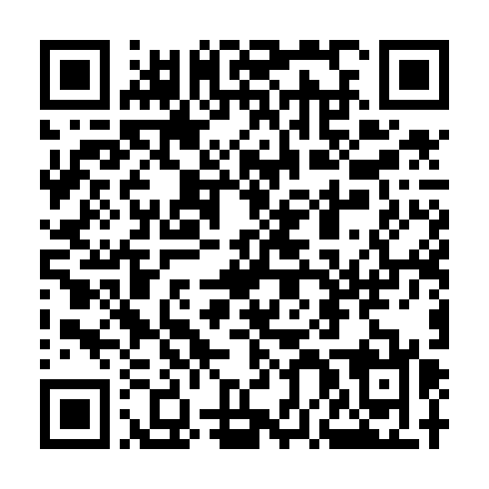
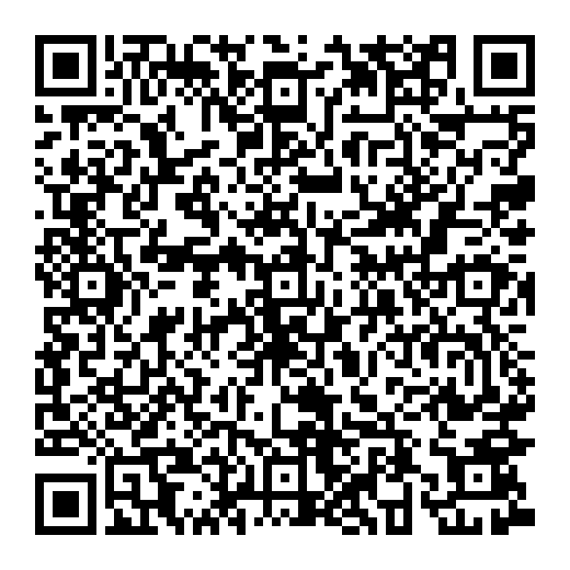
Where to Learn More
Legal Tip: 'Your Ethical Obligations When Presenting Offers’
NYSAR Affirmation Request Form
Notes:
LIBOR has prepared a detailed Legal Tip on our website, which breaks down exactly what has changed and what hasn’t.
The NYSAR form is also available on lirealtor.com.
The QR codes on the screen will take you to the legal tip and nysar affirmation form

Slide 20
LIBOR’s Ombudsman Program

Slide 21
Disputes Can Be Costly
Defense costs alone for an Errors & Omissions (E&O) claim frequently run from the high‑five figures into six figures, even when a case settles or is dismissed.
Even if insurance provides coverage, there will be a deductible.
Brokers also need to consider that disputes often result in a loss of time, productivity, damage to reputation, stress and anxiety.
Notes:
Deductibles are going up.
More complex claims (dual agency disputes, failure‑to‑disclose allegations, fiduciary duty claims) can push out‑of‑pocket legal fees well above $100,000, particularly if coverage limits are exhausted or deductibles apply

Slide 22
Consider Using LIBOR’s Free Ombudsman Program to Resolve Disputes
Ombudsman program is a free service that provides LIBOR members access to a trained and experienced REALTOR® who can help resolve conflicts before they become serious problems.
Ombudsman is an impartial party who functions as an intermediary, listening to each party and communicating the concerns of one party to the other over the phone, so a positive relationship can be restored.
Notes:
NAR Requires all Realtor Associations to have an ombudsman program

Slide 23

The Ombudsman Process
Situations usually involves parties who have not yet filed a lawsuit, ethics complaint or arbitration request but have experienced a breakdown in communication requiring informal resolution.
Disputes brought to an Ombudsman can typically be resolved in a matter of a few days or even hours through phone calls.
The entire Ombudsman process is confidential.

Slide 24

The Ombudsman Is Not a Judge
The Ombudsman does not advocate for either party or decide who is “right” or “wrong”.
Instead, the Ombudsman discusses misunderstandings and disagreements with the parties involved in an effort to identify key issues and reach a prompt solution.
Goal is to facilitate efficient resolutions that everyone can be happy with before they ripen into disputes or complaints.
Notes:
Ther’s not a hearing.. There’s not a confrontation with other side

Slide 25

The Process Has Little Downside
If the Ombudsman’s efforts are unsuccessful, the Ombudsman will advise the complainant about the next steps in the complaint process should the complainant wish to file a formal Code of Ethics complaint.

Slide 26
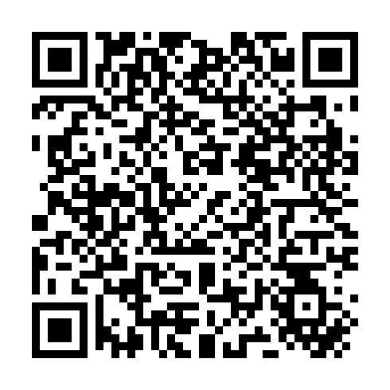
How To Seek Ombudsman Assistance
LIBOR full-time Professional Standards Department Staff can be reached at (631) 661-4800 (press 3).
LIRealtor.com also has an extensive Dispute Resolution Center with more information.

Slide 27
Proper Use of
“Coming Soon” Listings
Notes:
This presentation explains the proper and lawful use of the 'Coming Soon' listing status under New York law and OneKey® MLS rules. The focus is compliance, risk reduction, and ensuring decisions advance the seller’s best interests.

Slide 28
What Is a 'Coming Soon' Listing?
A limited, temporary status
Used before full market exposure
Often misunderstood and misused
Notes:
Many MLSs don’t offer status (approx. 20%) and about half of those that do don’t put on IDX or show publicly. One Key does
Also it’s not just regulated by MLS. Improper use of the status can drive licensing complaints. From seller’s or cooperating brokers

Slide 29
New York Legal Standards
There is no law in New York that specifically governs the use of “Coming Soon.”
However, all real estate advertising must be truthful.
NY Real Property Law §441-c prohibits misleading advertising.
Advertising a property inaccurately — even by implication — can constitute a violation.
This standard applies to all listing marketing, including “Coming Soon.”
Notes:
Although no statute specifically governs 'Coming Soon,' all real estate advertising must be truthful. Advertising a property inaccurately — even by implication — can constitute a violation.

Slide 30
Broker Fiduciary Duties
Brokers owe fiduciary duties to their sellers, including
  loyalty,
  disclosure,
  reasonable care, and
  the obligation to act in the seller’s best interest.
These duties require that marketing decisions be made to benefit the seller—not to advance the broker’s personal or business interests.
Using “Coming Soon” to generate buyer leads or double-end transactions conflicts with fiduciary duties.
Notes:
Reinforce that brokers must act for the seller’s benefit. Using 'Coming Soon' to generate buyer leads or double-end transactions conflicts with fiduciary duties.

Slide 31
When
“Coming Soon” is Appropriate
“Coming Soon” may be appropriate when there is a legitimate, seller directed reason to delay active marketing, such as when the seller:
  Is preparing the property for sale (repairs, staging, or cleanup);
  Is not yet ready for showings; or
  has requested a brief, defined pre-marketing period.
Delay should be limited in duration and must clearly serve the seller’s interests.
Notes:
Appropriate use requires a legitimate, seller-directed reason such as repairs or staging. The timeline should be short, purposeful, and connected directly to readiness for showings.
That understanding should inform—not follow—the seller’s decision to use “Coming Soon.”

Slide 32
Seller Informed Consent
Seller must understand that delaying exposure may limit buyer access and affect pricing or competitive bidding.
Consent must be informed and upfront.
Sellers should understand potential downsides before choosing this status – not after.
Notes:
Consent must be informed and upfront. Sellers should understand potential downsides, including fewer buyers and impact on competitive pricing — before choosing this status.

Slide 33
Improper Use Examples
Allowing select showings.
Lead generation for broker.
Listing already under contract.
If showings are occurring—even a single showing—the property is not truly “Coming Soon,” and advertising it as such may be misleading.
Notes:
If any showings occur — even one — the listing is no longer 'Coming Soon.' Selective access, internal buyer marketing, or using the status once a deal is effectively pending is misleading.
Advertising that implies availability or showings Any language suggesting appointments, early access, or private tours violates the rule

Slide 34
OneKey® MLS Rules
OneKey® MLS Rule 302.3 permits use of the “Coming Soon – No Showings” status solely for a short, temporary period to allow a property to be prepared for showings, after which the listing must become fully Active.
A listing may remain in “Coming Soon” status for no more than 14 days from the Listing Date and may not be extended or reinstated once it becomes Active.
Written seller authorization required.
Notes:
OneKey® strictly limits this status. Written seller authorization is required, including acknowledgment of the On-Market Date. The status automatically expires.

Slide 35
Key Restrictions
No showings allowed
Limited advertising only consistent with OneKey’s rules
Must convert to Active status on the on-market date.
Notes:
Marketing is limited to what OneKey® permits. Once the listing becomes Active, it cannot revert to 'Coming Soon.' Extensions are not allowed.

Slide 36
Permitted Advertising of “Coming Soon”
Display within OneKey® MLS: The listing appears in the MLS, IDX feeds, VOW websites, and MLS‑powered mobile apps.
Company Website: May be displayed on the brokerage’s website, provided it is clearly marked “Coming Soon.”
Email Marketing: May be emailed to clients, agents, or offices, so long as it is labeled “Coming Soon” and no showings are offered.
Social Media & Flyers: Allowed on social media posts and printed materials (flyers), with clear “Coming Soon” identification.
Yard Signs: Yard signs are permitted if they indicate “Coming Soon” (the On‑Market Date is not required on the sign.
Notes:
Misuse exposes licensees to Department of State discipline, MLS penalties, ethics complaints, commission disputes, and potential civil liability if seller harm can be demonstrated.

Slide 37
Bottom Line
“Coming Soon” is not a branding or lead-generation strategy for brokers.
It is a seller driven status that must be used carefully, documented appropriately, and implemented only when it clearly serves the seller’s best interest.
Must comply with law, ethics, and MLS rules.
Misuse can lead to serious penalties.
Notes:
Misuse exposes licensees to Department of State discipline, MLS penalties, ethics complaints, commission disputes, and potential civil liability if seller harm can be demonstrated.

Slide 38
NAR Buyer Side Class Action Settlement

Slide 39
Tuccori Settlement – Overview
NAR has reached a settlement agreement in Tuccori et al. v. At World Properties et al.
Tuccori is a nationwide class‑action antitrust lawsuit concerning buyer‑agent commissions
A related case, Batton v. NAR, is expected to be stayed, as the Tuccori settlement is intended to release those claims

Slide 40
Purpose and Strategic Context
Settlement is intended to protect REALTOR® members and the industry
Aligns with NAR’s 2026–2028 Strategic Plan and a more proactive legal strategy
Resolves claims early to avoid significant potential liability
Reflects a move toward certainty and risk mitigation for members and associations

Slide 41
Scope and Practical Impact of Settlement
No new practice changes required beyond those already implemented under the Sitzer/Burnett settlement.
Settlement release covers:
  REALTOR® members
  State and local REALTOR® associations (with or without MLSs)
  REALTOR® and non‑REALTOR® MLSs
  Brokerages with a REALTOR® principal that meet eligibility criteria
Coverage applies only to entities in compliance with NAR rules and not asserting contrary claims.
Notes:
Double-check AI-generated property descriptions, market data, or other outputs for errors.
Clearly communicate with clients when AI tools are being used and explain any potential limitations.
Avoid over-relying on AI in areas where professional expertise is required, such as legal or financial advice, and always refer clients to licensed professionals when necessary.

Slide 42
Sitzer Burnett Settlement Reminder
MLS & Compensation Practice Changes
No offers of compensation in the MLS: Buyer‑broker compensation may not be advertised, displayed, or set in MLS listings or fields.
No indirect compensation signaling: MLS listings may not include language, codes, or remarks that signal compensation outside the MLS.
Compensation is fully negotiable and off‑MLS: Any buyer‑broker compensation must be negotiated separately between brokers and/or with consumers.
Prohibition on steering tied to compensation: Agents may not filter, select, or recommend properties based on whether compensation is offered.

Slide 43
Sitzer Burnett Settlement Reminder
Buyer Representation & Transparency Requirements
Prior to touring a home with a buyer, an MLS participant or its agents must have a written buyer agreement that:
  Discloses the amount or rate of compensation the broker will receive;
  Provides that compensation is objective ascertainable (e.g., $0, X flat fee, X percent, X hourly rate) and not open-ended;
  States the broker is prohibited from receiving compensation for brokerage services from any source that exceeds the amount or rate agreed to in the agreement with the buyer; and
  Include a conspicuous statement that broker fees and commissions are fully negotiable and not set by law.

Slide 44

Do NOT Try Any of These NAR Settlement “Workarounds”
Accepting Seller-Paid Bonuses
Supplementing Touring or Showing Agreements for a Property Already Shown with a Buyer Representation Agreement
Including Ranges of Compensation in a Buyer Representation Agreement
Tailoring a Buyer Representation Agreement to Seller-Offered Compensation or Leaving Compensation Open-Ended to be Filled in Based on Whatever Compensation the Seller or Listing Broker May be Offering

Slide 45

Lawful Source of Income Discrimination Update
Notes:
Major areas of testing…DOS Complaints up 35% over last year – same number of licensees

Slide 46
What Is Lawful Source of Income (SOI)
Became a Protected Class in NY in April 2019.
Housing providers may ask about income, and about the source of income, and require documentation, in order to determine a person’s ability to pay for the housing accommodation.
But must accept all lawful sources of income equally.

Slide 47

Lawful Source of Income Includes:
Child support.
Alimony.
Foster care subsidies.
Income derived from social security.
Any form of federal, state, or local public assistance.
Housing assistance including, but not limited to, Housing Choice Vouchers (Section 8) or any other vouchers.
Any other form of housing assistance payment or credit whether or not such income or credit is paid or attributed directly to a landlord, and any other forms of lawful income.

Slide 48
Recent Third Department Court Ruling
In March, the New York State Supreme Court, Appellate Division (Third Department), issued a decision holding that New York’s lawful source of income protections cannot be used to require property owners to participate in the federal Section 8 program.
The court found the law unconstitutional in situations where it would force owners to consent to warrantless inspections and provide access to records.

Slide 49
For Now, the Ruling Does Not Change Anything!
The New York State Attorney General has appealed the decision.
In NY, when the state appeals, the ruling is automatically stayed.
As a result, all lawful source of income protections in New York State, New York City, Nassau County and Suffolk remain fully in effect, including protections for Section 8 voucher holders.
Even if the Court of Appeals upholds the decision, it will only have a limited impact on Section 8, and program may then make an adjustment.
Notes:
Many lawsuits related to undercover testing – HRI

Slide 50

So You Must Continue to Follow ALL Lawful Source of Income Laws
All lawful source of income laws remain in full force and effect.
The ruling does not pause or prevent enforcement.
Why is that important?
What does that mean?
Notes:
Many lawsuits related to undercover testing – HRI

Slide 51

Undercover Testing Continues to Result in Violations
May 2025: Long Island agent allegedly told testers that they could not use Section 8 vouchers or Veterans Affairs Supportive Housing vouchers to pay rent.
November 2024: Baldwin apartment complex paid $20K for telling testers “we don’t participate in programs for section 8” And that “certain buildings they’ll participate in it, but we’re just not one of the one that are.”
April 2024: Suffolk County apartment complexes paid over $100,000 for allegedly telling renter a voucher would be insufficient even though it provided enough to pay the rent and saying the complex had “reached its quota” on individuals using housing subsidies.
ZERO Tolerance: DOS will seek license suspension or revocation for violations.
Notes:
Many lawsuits related to undercover testing – HRI

Slide 52
Recent December 2025
NYS DHR Case
Fair Housing Justice Center (FHJC) conducted tests where individuals posed as renters—some with employment-based income and some with income from housing vouchers.
FHJC alleged disparities in the way agents treated the testers who presented as having employment-based income versus the testers who said they had vouchers.
Agents “ghosted” or stopped responding to person once they indicated that they will cover rent using a housing voucher.
In other circumstances, listings explicitly stated that vouchers were not accepted.
Brooklyn brokerage and agents agreed to $40,000 settlement with NYSDHR.

Slide 53

What Can SOI Discrimination Look Like?
Failing to respond to inquires from voucher holders.
Making Any of the following statements:
I don’t work with voucher holders.
I don’t work with landlords who take vouchers.
Let me find out if the owner takes vouchers and get back to you.
This apartment does not take vouchers.
There is a “waitlist” for people with vouchers.
This apartment only takes Section 8 tenants with jobs.
This apartment takes section 8, but you have to pay the rent for the first month or two.

Slide 54
Have Procedures in Place to Prevent Lawful
Source of Income Discrimination
Have standard procedures for ALL prospects regardless of their source of income.
Ask the same questions you would ask any other prospective tenant:
  What area are you looking in?
  How any bedrooms are you looking for?
  What is your price range?
Don’t turn away prospects because they receive financial assistance.
When meeting prospects, tell them about all vacancies that meet their needs, regardless of their source of income.
Show voucher holders the same apartments that you would any other prospective tenant regardless of their source of income
Ask voucher holders for (1) copy of voucher, (2) name of caseworker; and (3) educate yourself to the details of the program.

Slide 55

What Should I Do if an Owner Refuses to Accept Housing Vouchers or Subsidies?
Never under any circumstances abide by a property owner’s instruction to refuse to rent to tenants seeking to pay for housing with housing assistance vouchers, subsidies, or other forms of public assistance such as Section 8.
Advise the owner that refusing to work with voucher holders is unlawful, you cannot follow their directive and stop working with that owner. Source of income discrimination must be treated like any other discrimination.

Slide 56

Can a Landlord Require a Credit Check or a Certain Credit Score for Voucher Holders?
If voucher covers 100% of the rent, the landlord cannot require a credit check or reject the tenant based on a negative credit history.
If tenant is paying a portion of the rent, credit may be considered on a case-by-case basis, but requiring a minimum credit score may still violate source of income discrimination laws.
Credit scores and history may not be valid indicators of whether a person with a partial subsidy will pay the rent. Voucher holders often have low or no credit, so requiring a specific credit score may have the effect of excluding renters with subsidies.
Notes:
May trigger an investigation by the New York City or State Human Rights Commission.

Slide 57

Cold Calling Is Still Prohibited

Slide 58
Cold Calling Is Still Not Allowed in New York
General Business Law §399-z(5)(a) prohibits unsolicited telemarketing sales calls during a declared state of emergency.
EO 47.16: Public Order at Correctional Facilities (Originally declared February 19, 2025). Until at least April 24, 2026.
EO 52.8: Federal Actions Related to Vaccine Mandates. Until at least May 17, 2026
These may be extended.
Real estate licensees may not make any unsolicited phone calls or text messages to a member of the public who they do not have an Established Business Relationship with during a State of Emergency.
All other types of marketing such as mailers, billboards, social media, internet etc., are permitted.

Slide 59
What Constitutes an Established Business Relationship?
An Established Business Relationship (EBR) is a voluntary two-way communication forming a relationship based on:
  a purchase/transaction within 18 months, or
  an inquiry/application within 3 months
Calling on another broker’s expired listings, trying to solicit the listing of a FSBO or calling on leads you paid for are not examples of an EBR.

Slide 60
Department of State Can Enforce Cold Call Laws Based on Complaints
DOS has reportedly been enforcing violations of telemarking laws.
Possible fines of up to $20,000 per call.
DOS is seeking to impose strict liability and hold brokerages and their owners liable for calls made by salespersons.
One reported instance DOS is seeking to hold respondent licensees collectively liable for over $13 million in connection with over 250 allegedly improper cold calls.

Slide 61
NYSAR is Lobbying to Get the Law Changed
On January 12, the State Assembly unanimously passed NYSAR-supported legislation (A.1250/S.6853) that would amend current law and lift restrictions on legitimate telemarketing business services provided by licensed professionals.
The bill would stipulate the ability to provide telemarketing services during states of emergency when it is founded that such telemarketing services would not impair or mitigate a declared state of emergency.
NYSAR is urging the State Senate to prioritize this bill during the 2026 legislative session.
Members should support NYSAR Calls to Action!

Slide 62
Once Cold Calling Is Permitted,
Brokerages Must Comply With Other NYS Laws
On January 1, 2025, New York State enacted the so-called Seinfeld law
The law requires telemarketers to do the following within the first 30 seconds of an unsolicited sales call:
  State the caller's name.
  Identify the company they represent.
  Disclose the purpose of the call.
  Reveal if the call is being recorded.
  Offer the call recipient the option to be added to the company's internal "do not call" list.
Notes:
The law's name stems from a scene in the Seinfeld episode "The Pitch" where Jerry asks a telemarketer for his home phone number so he can call him back. When the telemarketer refuses, Jerry points out the hypocrisy of not wanting to be called at home when he is calling others without their consent

