Slide 1
THE STATE OF LONG ISLAND
REAL ESTATE
RESIDENTIAL AND COMMERCIAL
MARKET CONDITIONS
NADIA EVANGELOU | Senior Economist & Director of Real Estate Research
National Association of REALTORS®

Slide 2


PRICES UP: THEN AND NOW
Median home prices
Nassau County
55% up from 2019
Suffolk County
64% up from 2019
$860,000
$805,000
$702,000
$659,000
$555,000
$427,000
July 2019
July 2024
July 2025
July 2019
July 2024
July 2025
Source: Long Island Board of REALTORS®

Slide 3

SALES DOWN: THEN AND NOW
Closed Single-Family Home Sales
(YTD, January through July)
Nassau County
28% down from 2019
Suffolk County
33% down from 2019
8,527
5,940
5,879
5,673
4,484
4,281
2019
Jan-Jul
2024
Jan-Jul
2025
Jan-Jul
2019
Jan-Jul
2024
Jan-Jul
2025
Jan-Jul
Source: Long Island Board of REALTORS®

Slide 4
WEAK AFFORDABILITY IN BOTH COUNTIES
Monthly Mortgage Payment
Qualifying Income
Typical Family Income
$4,350
$208,750
$178,810
Nassau County
Nassau County
Nassau County
$3,550
$170,400
$158,890
Suffolk County
Suffolk County
Suffolk County

Slide 5
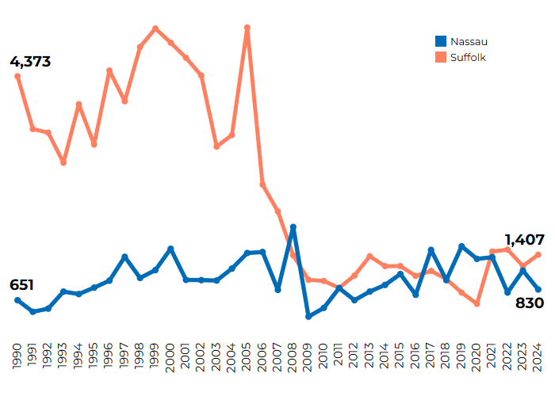
CONSTRUCTION IS RISING IN SUFFOLK BUT FALLING IN NASSAU COUNTY
Building Permits (1990-2024)
Suffolk
Building permits
49% down
from the pre-pandemic historical average
Nassau
Building permits
16% down
from the pre-pandemic historical average
Source: U.S. Census Bureau

Slide 6
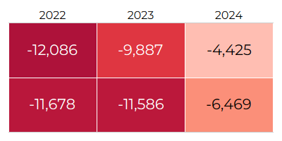
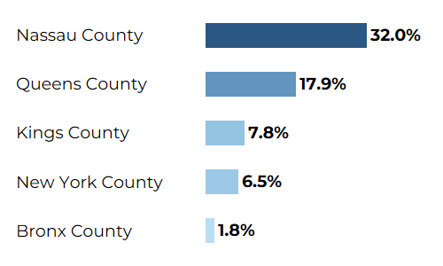
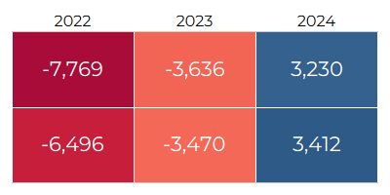
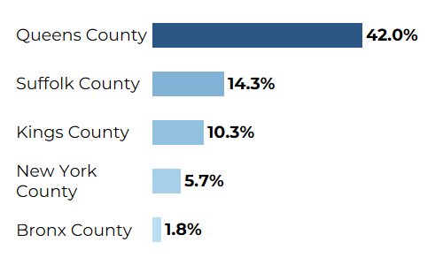
ATTRACTING MORE RESIDENTS THAN THE RECENT YEARS
Origin of Movers
Suffolk County
Domestic Migration
Nassau
Suffolk
Net Migration
Nassau County
Nassau
Suffolk
Source: Population Estimates, U.S. Census Bureau
Source: IRS migration data

Slide 7



PERSONA OF HOME BUYERS
United States
Suffolk County
Nassau County
Homeownership rate:
65.3%
Homeownership rate:
81.3%
Homeownership rate:
81.3%
Josh
Age: 42
5.7% of all homeowners
-Median household income: $99,440
Higher education: 21%
- Moved from different state: 16%
White: 70%, Black: 8%, Asian: 7%, Hispanic: 14%
Married couples: 53%, Single women: 12%,
Jenna
Age: 40
3.8% of all homeowners
- Median household income: $114,820
Higher education: 19%
Moved from different state: 6%
White: 59%, Black: 7%, Asian: 9%, Hispanic: 22%
Married couples: 41%, Single women: 14%,
Michael
Age: 41
3.9% of all homeowners
- Median household income: $139,840
- Higher education: 30%
Moved from different state: 3%
White: 56%, Black: 12%, Asian: 15%, Hispanic: 11%
Married couples: 51%, Single women: 8%,

Slide 8
WHAT HOMES BUYERS ARE PURCHASING
United States
Suffolk County
Nassau County
Josh
Median property value:
$372,970
50% of these homes were built in the 1990s or later
All cash buyers: 29%
- Median monthly cost: $1,920
Median annual property taxes: $3,250
- Median annual home insurance cost: $1,280
Jenna
Median property value:
$582,420
57% of these homes were built before the 1970s
All cash buyers: 36%
- Median monthly cost: $2,960
Median annual property taxes: $9,330
- Median annual home insurance cost: $1,680
Michael
Median property value:
$685,100
67% of these homes were built before the 1960s
All cash buyers: 28%
- Median monthly cost: $4,040
Median annual property taxes: $10,290
- Median annual home insurance cost: $1,330

Slide 9
IMPACT OF LOWER MORTGAGE RATES
Number of households who can afford to buy the median-priced home
Additional
home sales
In the next 12-18 months
7% rate
6% rate
Suffolk County
2,590
in Suffolk County
150,304
households
176,163
households
Nassau County
7% rate
6% rate
2,060
In Nassau County
124,779
households
145,422
households

Slide 10

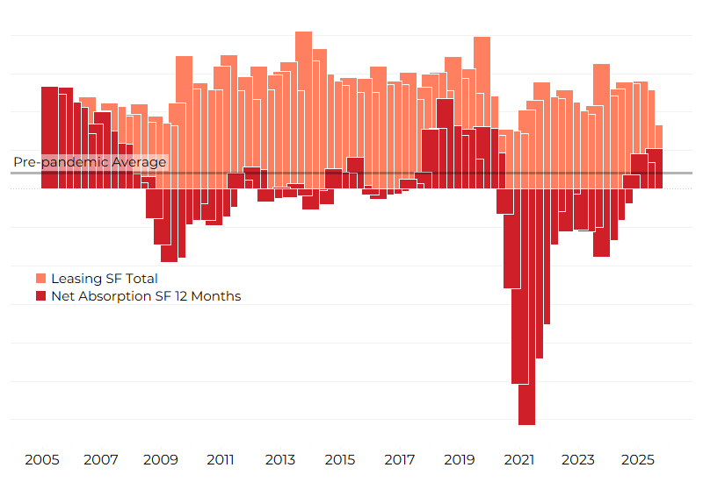

OFFICE SECTOR: THE NEW YORK METRO AREA IS
OUTPERFORMING
Net absorption (12 months): 5.2 million sq. ft
Pre-pandemic average: 2.1 million sq. ft.
Rent Growth
0.7%
New York
0.8%
U.S.
vs
Vacancy Rate
13.5%
New York
14.1%
U.S.
vs
Source: CoStar

Slide 11
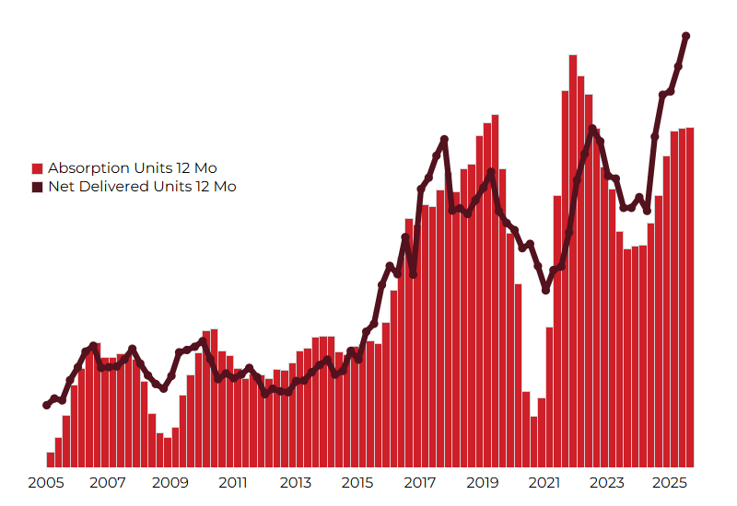
MULTIFAMILY SECTOR: THE BRIGHT SPOT OF THE
MARKET
NEW YORK METRO AREA
Rent Growth
Net absorption (12 months): 30,162 units
2.7%
New York
0.9%
U.S.
Pre-pandemic average: 13,153 units
vs
Vacancy Rate
3.4%
New York
8.2%
U.S.
vs
Source: CoStar

Slide 12
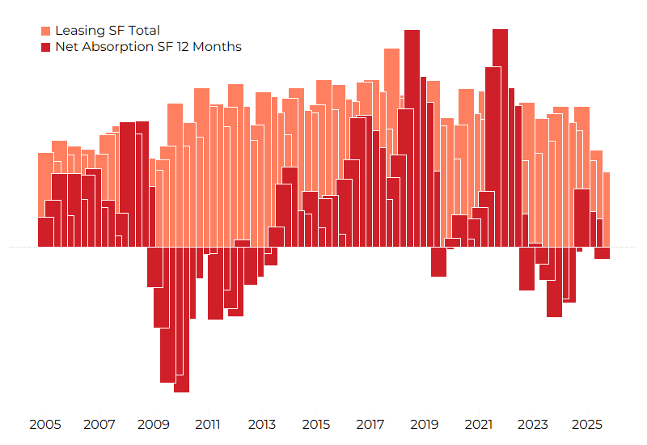
INDUSTRIAL SECTOR IS SLOWING DOWN
NEW YORK METRO AREA
Net absorption (12 months): -849,976 sq. ft.
Pre-pandemic average: 2.3 million sq. ft.
Rent Growth
0.9%
New York
1.6%
U.S.
vs
Vacancy Rate
7.7%
New York
7.5%
U.S.
vs
Source: CoStar

Slide 13


METRO MARKET STATISTICS DASHBOARD
COMMERCIAL REAL ESTATE MARKET REPORTS

Slide 14

Email: nevangelou@nar.realtor
LinkedIn: www.linkedin.com/in/nadiaevangelou

