Slide 1
Long Island Housing Services, Inc.
LIFairHousing.org

Slide 2
Fair Housing:
Doing Well by Doing Good!
A Blue Ocean Strategy for Real Estate Agents
Ian Wilder, Esq
Executive Director
April 3, 2024
Long Island Housing Services’ Mission:
Elimination of unlawful Housing discrimination and promotion of decent and affordable housing
through advocacy and education
Mar-24
Long Island Housing Services, Inc.
LIFairHousing.org

Slide 3
Who is
Ian Wilder
?
BBA, Management, Hofstra University 1987
JD, George Washington University, 1993
Real Estate Attorney 1994 - 2008 (14 years)
Co-op Board Member and Treasurer 2005-2011
Long Island Housing Services Executive Director 2018-Present
City & State magazine Long Island Power 100 in 2022, 2021, and 2020
Touro Podcast with LIBOR Assoc. General Counsel 2022
Long Island Press Real Estate Power Players 2023
Newsday Co-op Transparency Law Op-Ed co-authored with LIBOR CEO 2023
Ian@LIFairHousing.org 631-567-5111 ext. 314
Mar-24
Long Island Housing Services, Inc.
LIFairHousing.org

Slide 4
Review of Fair Housing Laws. https://www.lifairhousing.org/resources-links/
Introducing Blue Ocean Strategy Approach. https://www.blueoceanstrategy.com/
Overview
Long Island Housing Services, Inc.
LIFairHousing.org
Mar-24

Slide 5
Overview of County, State and Federal Fair Housing Laws
Key Provisions and Protected Classes
Cost of Non-Compliance
Understanding Fair Housing Laws
Long Island Housing Services, Inc.
LIFairHousing.org
Mar-24

Slide 6
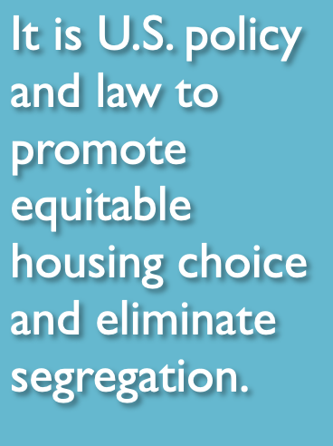
What is Fair Housing?
Fair housing means that all people have the right to live in the housing of their choice that they can afford free from discrimination.
Discrimination: Denial of equal treatment and opportunity.
Long Island Housing Services, Inc.
LIFairHousing.org
Mar-24

Slide 7
What is Fair Housing?
Fair housing laws ensure equal access .
They mandate that people have equal housing opportunities.
They require people not be subjected to discrimination based upon legally protected categories.
Long Island Housing Services, Inc.
LIFairHousing.org
Mar-24

Slide 8
Who is protected
under the
Fair Housing Laws
?
Long Island Housing Services, Inc.
LIFairHousing.org
Mar-24

Slide 9
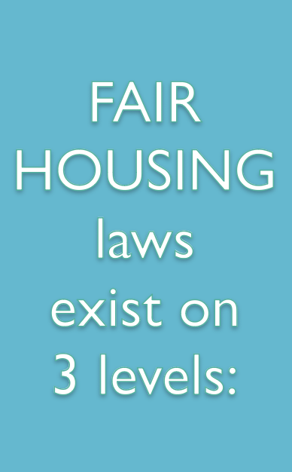
U.S. Government
New York State
County
Long Island Housing Services, Inc.
LIFairHousing.org
Mar-24

Slide 10
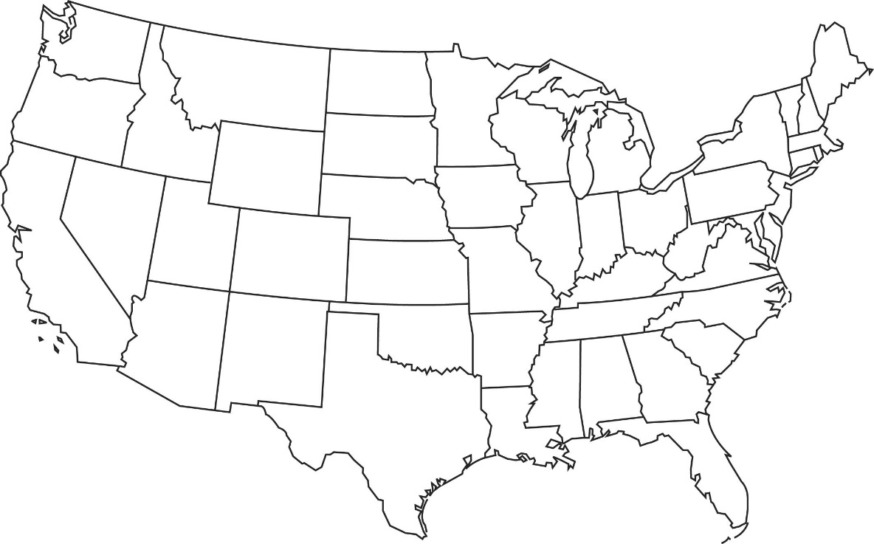
It is against Federal (U.S. Government) Fair Housing Law to
discriminate in housing because of a person’s:
Race
Color
National Origin
Religion
Disability
Familial Status
Sex including Sexual Orientation and Gender Identity
Long Island Housing Services, Inc.
LIFairHousing.org
Mar-24

Slide 11
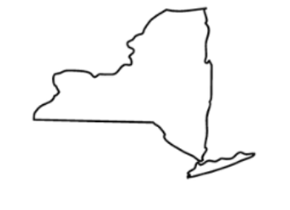
In New York State, it is against the law to discriminate
in housing due to a person’s:
Marital status
Sexual orientation
Gender Identity
Gender Expression
Source of Income*
Military Status
Age (over 18)
Creed
Arrest**
Status as a Domestic Violence Victim
Citizenship and Immigration status
Race, including hair texture and protective hairstyles
*Source of income includes public assistance, Section 8, SSD, SSI, and court-ordered child support.
** Arrest includes favorably resolved arrest, an adjournment in contemplation of dismissal (ACOD), and a sealed conviction record, or a youthful offender adjudication.
Long Island Housing Services, Inc.
LIFairHousing.org
Mar-24

Slide 12
In Suffolk County, it is also against the law to discriminate in housing
because of a person’s:
Group Identity*
Source of Income
Veteran Status
Age (over 18)
*Group Identity includes actual or perceived:
Alienage or Citizenship Status
Gender
Sexual Orientation
Military Status
Mar-24
Long Island Housing Services, Inc.
LIFairHousing.org

Slide 13
In Nassau County, it is also against the law to discriminate
in housing because of a person’s:
Ethnicity
Veteran Status
First Responder Status
Source of Income
Long Island Housing Services, Inc.
LIFairHousing.org
Mar-24

Slide 14
I am
Male
White
58yo
Jewish
Father
Cisgender
Heterosexual
Disabled
Husband
All Potential Protected Classes
Long Island Housing Services, Inc.
LIFairHousing.org
Mar-24

Slide 15
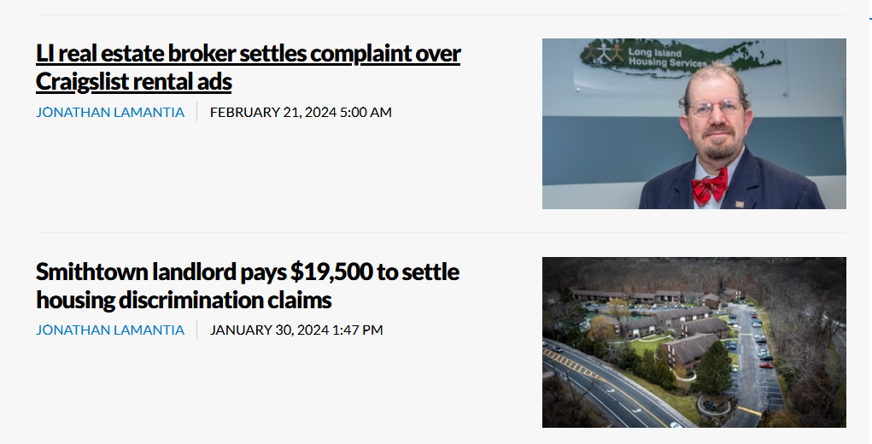
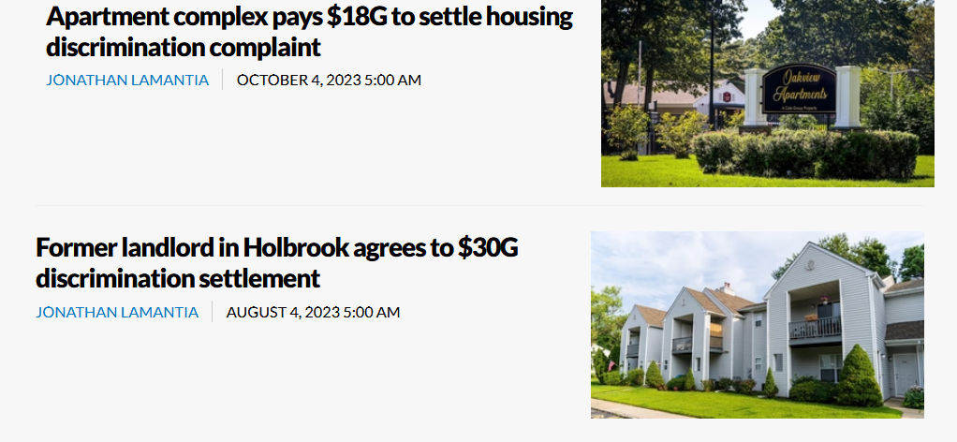
Cost of non-compliance

Slide 16
What is Blue Ocean Strategy
?
Long Island Housing Services, Inc.
LIFairHousing.org
Mar-24

Slide 17
The Blue Ocean Strategy
The Blue Ocean Strategy is about shifting
from competing in
a crowded market (the "red ocean")
to creating value for both our clients and ourselves (the "blue ocean").
Long Island Housing Services, Inc.
LIFairHousing.org
Mar-24

Slide 18
The Blue Ocean Strategy
Blue Ocean Strategy was coined by two Harvard professors, Chan Kim and Renée Mauborgneis, who created the term to describe the existing market universe.
The strategy involves the simultaneous pursuit of differentiation and low cost to open up a new market space and create new demand.
Unlike traditional strategies, it aims to create new, uncontested market spaces.
In doing so, it provides a systematic approach to making the competition irrelevant.
Source: BlueOceanStrategy.com
Long Island Housing Services, Inc.
LIFairHousing.org
Mar-24

Slide 19
Key Principles of Blue Ocean Strategy
1. Value Innovation
Shift: Move away from the value-cost trade-off
Create: Innovate to provide unique value to customers
Break: Challenge industry assumptions and break away from conventional thinking
2. Systematic Approach
Eliminate: Remove factors that don’t add value.
Reduce: Scale down certain features or costs.
Raise: Enhance other factors to differentiate.
Create: Introduce new elements that redefine the industry
3. Alignment - Whole System Approach
Align all activities within the organization toward differentiation and low cost.
Ensure consistency across strategy, processes, and execution.
Long Island Housing Services, Inc.
LIFairHousing.org
Mar-24

Slide 20
Blue Oceans vs Red Oceans
Red Oceans contain existing industries with well-defined boundaries and competitive rules in a saturated market.
By contrast, Blue Oceans shift from competing in a crowded market to creating value for both our clients and ourselves
While Red Oceans are “bloody” oceans due to fierce rivalry, Blue Oceans are vast and unexplored, waiting for pioneers.
Long Island Housing Services, Inc.
LIFairHousing.org
Mar-24

Slide 21
Blue Oceans vs Red Oceans
Blue Ocean Strategy Definition: Industries not yet in existence – untouched by competition. Objective: Create and capture new demand by offering unique value. Opportunity: Growth that is both profitable and rapid. Metaphor: Vast, unexplored ocean waiting for pioneers. | Red Ocean Strategy Definition: Existing industries with well-defined boundaries and known competitive rules. Objective: Companies compete to grab a greater share of existing demand. Challenges: Crowded markets, reduced profits, commoditization, and intense competition. Metaphor: “Bloody” oceans due to fierce rivalry. .
Long Island Housing Services, Inc.
LIFairHousing.org
Mar-24

Slide 22
Blue vs. Red
Example
Blue Ocean Strategy Yellowtail wines opened up a new market to casual wine drinkers in the United States | Red Ocean Strategy Legacy wine brands from California, France, and Italy competed heavily in the market of experienced wine drinkers, leaving the market saturated.
Long Island Housing Services, Inc.
LIFairHousing.org
Mar-24

Slide 23
yellow tail wine Blue Ocean Strategy
Background
Yellow Tail was founded in 2001 by the Casella family, who immigrated from Sicily to New South Wales, Australia.
Rather than competing head-on with French or Italian wines, Yellow Tail took a different approach.
Long Island Housing Services, Inc.
LIFairHousing.org
Mar-24

Slide 24
yellow tail wine Blue Ocean Strategy
By identifying and answering the needs of a specific and new market in the US, Yellow Tail applied the four actions framework of Blue Ocean Strategy:
Reduce: Reduced complexity and vineyard prestige.
Create: Created an easy-drinking wine.
Raise: Elevated price versus budget wines.
Eliminate: Eliminated aging qualities.
Yellow Tail’s brand positioning in the US focused on being fun, approachable, and easy to drink, appealing to beer and cocktail drinkers as well as non-wine consumers.
Long Island Housing Services, Inc.
LIFairHousing.org
Mar-24

Slide 25
yellow tail wine Blue Ocean Strategy
Results
Yellow Tail’s clever marketing mix led to unexpected success:
They sold 1 million bottles in the US within a year, far exceeding the predicted 25,000 sales.
By 2003, Yellow Tail became the fastest-growing wine brand in the US.
It even surpassed Californian, French, and Italian brands, emerging as the number one red wine in 750ml bottles.
Long Island Housing Services, Inc.
LIFairHousing.org
Mar-24

Slide 26
yellow tail wine Blue Ocean Strategy
Conclusion
Yellow Tail’s strategic move exemplifies how a blue ocean approach can transform a small brand into a global success story.
Their focus on simplicity, accessibility, and enjoyment disrupted the traditional wine industry and created a new market.
Long Island Housing Services, Inc.
LIFairHousing.org
Mar-24

Slide 27
Blue vs. Red
Example # 2
Blue Ocean Strategy Airbnb turned private homes into temporary lodging options for travelers Distinguished itself from traditional hotel accommodations | Red Ocean Strategy By contrast, chains like Hilton and Marriott directly compete within the established short-term lodging market.
Long Island Housing Services, Inc.
LIFairHousing.org
Mar-24

Slide 28
Blue vs. Red
Example # 3
Blue Ocean Strategy Netflix pioneered the streaming industry, moving away from traditional DVD Rental | Red Ocean Strategy Cable and Satellite TV providers compete over existing market share through pricing and bundle packages
Long Island Housing Services, Inc.
LIFairHousing.org
Mar-24

Slide 29
How do you apply Blue Ocean Strategy to
Fair Housing
in Real Estate
?
Long Island Housing Services, Inc.
LIFairHousing.org
Mar-24

Slide 30
Long Island Housing Services, Inc.
LIFairHousing.org
Mar-24

Slide 31
Using Blue Ocean Strategy apply Equal Access lens as a core value proposition.
Long Island Housing Services, Inc.
LIFairHousing.org
Mar-24

Slide 32
Blue Oceans vs Red Oceans
Blue Ocean Strategy View compliance as an opportunity to differentiate and create a new selling point | Red Ocean Strategy View fair housing compliance as a checkbox exercise, simply meeting the minimum requirements
Long Island Housing Services, Inc.
LIFairHousing.org
Mar-24

Slide 33
What Generational Shift
makes Fair Housing into
a Blue Ocean Strategy
?
Long Island Housing Services, Inc.
LIFairHousing.org
Mar-24

Slide 34
Silent Generation: Born 1928-1945 Boomers: Born 1946-1964 Gen X: Born 1965-1980 Millennials: Born 1981-1996 Gen Z: Born 1997-2012
Generations Defined
Long Island Housing Services, Inc.
LIFairHousing.org
Mar-24

Slide 35
Diversity of Generations
Silent Generation: The least diverse generation overall.
Baby Boomers: Similar demographically to the Silent Generation Approximately 82 percent of Boomers are non-Hispanic white.
Generation X: More racially diverse than previous generations LGBTQ visibility is increased compared to prior generations
Millennials and Gen Z- The most diverse generations in American history. A slim majority of the Gen Z cohort, 52 percent, is non-Hispanic white. One in four members of the Gen Z cohort are Hispanic. Five percent of Americans aged 18-29 identify as transgender or nonbinary, up from two percent in older age cohorts.
Source: Pew Research Center
Long Island Housing Services, Inc.
LIFairHousing.org
Mar-24

Slide 36
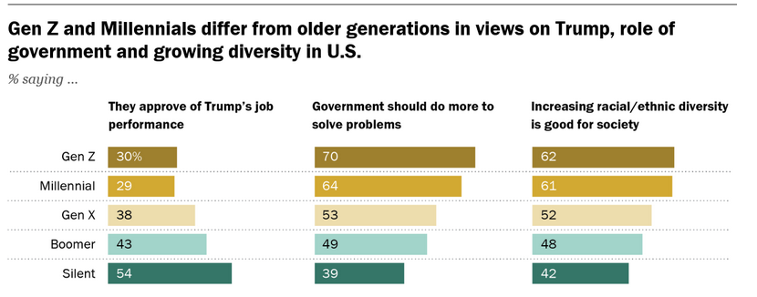
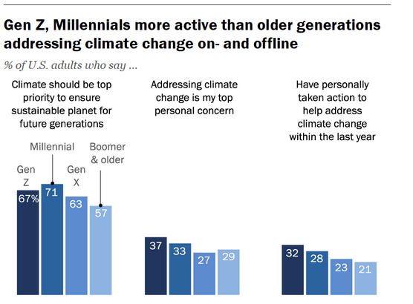
Majorities of Millennials (61%), Gen Z (62%), and Gen X (52%) believe that increasing racial diversity is good for society Baby Boomers and Silent Generation believe this less strongly Though all generations believe protecting the climate should be a top priority for future generations, Gen Z and Millennials are more likely to have taken personal action to mitigate it. Source: Pew Research Center
Generational Attitudes Towards Social Justice
Long Island Housing Services, Inc.
LIFairHousing.org
Mar-24

Slide 37
What tools exist
to make Fair Housing into a Blue Ocean Strategy
?
Long Island Housing Services, Inc.
LIFairHousing.org
Mar-24

Slide 38
Affirmatively Marketing Fair Housing
Affirmative marketing of fair housing involves actively promoting our commitment to fair housing laws.
It means integrating fair housing compliance into our brand identity and highlighting it in our marketing materials.
By doing so, we not only demonstrate our dedication to equality but also attract clients who value ethical and socially responsible business practices.
Long Island Housing Services, Inc.
LIFairHousing.org
Mar-24

Slide 39
Firstly, it enhances reputation and brand image, positioning us as leaders in our industry.
Secondly, it builds trust and loyalty with clients, who appreciate our commitment to fairness and equality.
Finally, it provides legal protection and mitigates the risk of potential lawsuits or complaints.
Benefits of Affirmatively Marketing
Fair Housing
Long Island Housing Services, Inc.
LIFairHousing.org
Mar-24

Slide 40
“You are not the client.”
Long Island Housing Services, Inc. LIFairHousing.org
Mar-24

Slide 41
What are examples of businesses
that Affirmatively Market for
Social Justice
?
Long Island Housing Services, Inc.
LIFairHousing.org
Mar-24

Slide 42
Affirmative Marketing Case Studies
These examples demonstrate the positive impact that embracing fair housing compliance can have on our business, from increased client satisfaction to improved morale.
Long Island Housing Services, Inc.
LIFairHousing.org
Mar-24

Slide 43
Case Study #1
CREDO Mobile is a cell phone carrier known for its commitment to social activism, donating over $87 million to progressive organizations since its founding.
In 2018 alone, CREDO launched more than 300 social justice campaigns, generating 27 million petition signatures and making over 114,000 calls to Congress.
The carrier continues to expand its reach, with a presence in 9 states ad more forthcoming in the future.
Source: Tides.org, “Carrier with a Conscience: An Interview with CREDO Mobile’s Ray Morris”
Long Island Housing Services, Inc.
LIFairHousing.org
Mar-24

Slide 44
Case Study #2
On Black Friday of 2011, Patagonia introduced a “Don’t buy this jacket” campaign. Unlike other brands that urged people to buy their goods, Patagonia explicitly requested otherwise.
The ad encouraged people to be environmentally conscious by not buying new gear they did not need, but to reduce, reuse and recycle instead.
Whether the campaign was altruistic or a case of reverse psychology, Patagonia sales rose 30% following the launch of the campaign.
Nonetheless, it spread the message of conscientious consumption worldwide.
Source: MarketingWeek, “Case study: Patagonia’s ‘Don’t buy this jacket’ campaign”
Long Island Housing Services, Inc.
LIFairHousing.org
Mar-24

Slide 45
Case Study #3
Ahead of the 2004 presidential election, ice cream brand Ben & Jerry’s introduced a campaign to register people to vote. It created a “Free Scoop Day” that April, during which it provided customers a way to register to vote in store.
Ben & Jerry’s also marketed its flavors at the Rock the Vote summer tour, a tour where music artists encourage young people to get out the vote.
As a result of their efforts, Ben & Jerry’s successfully convinced thousands of people to vote, while also increasing its own brand loyalty among consumers.
Source: “Case Study: Ben & Jerry's Social Initiative
Long Island Housing Services, Inc.
LIFairHousing.org
Mar-24

Slide 46
What is a Framework
for evaluating a business
for Social Justice
?
Long Island Housing Services, Inc.
LIFairHousing.org
Mar-24

Slide 47
B Corporations
B Corporations are businesses that meet the highest standards of social and environmental performance, public transparency, and legal accountability.
They are granted certification as a B Corporation by a non-profit called B Labs.
To qualify as a B Corporation, a business must receive a minimum score of 80 from an assessment of its social and environmental performance, integrate its social justice commitments into its bylaws, and pay an annual fee.

Slide 48
Well-Known B Corporations
Warby Parker
Ben & Jerry’s
Patagonia:
Natura
Seventh Generation

Slide 49
What are the steps to instituting a
Fair Housing
strategy
?
Long Island Housing Services, Inc.
LIFairHousing.org
Mar-24

Slide 50
Overcoming Challenges
Invest in training, tools, and protocols.
Addressing Resistance and Misconceptions.
Handling Compliance Concerns.
Leveraging Resources for Support.
Long Island Housing Services, Inc.
LIFairHousing.org
Mar-24

Slide 51
Conclusion
Differentiate by making fairness and equality into a central value.
Call to Action: start Affirmatively Marketing for Fair Housing today!
Long Island Housing Services, Inc.
LIFairHousing.org
Mar-24

Slide 53
Appreciation for Attendees.
Reminder to Stay Committed to Fair Housing.
Thank You!
Research and PowerPoint assistance from Paul Pezza and Andrew Adler
Mar-24
Long Island Housing Services, Inc.
LIFairHousing.org

Slide 54
Contact Information
Long Island Housing Services, Inc.
640 Johnson Ave., Suite 8
Bohemia, NY 11716-2624
631-567-5111 ext. 314
info@lifairhousing.org
Mar-24
Long Island Housing Services, Inc.
LIFairHousing.org

Slide 55
Q&A
Feedback
The floor is open.
Let’s hear your questions & comments
Long Island Housing Services, Inc.
LIFairHousing.org
Mar-24

Slide 56
Mar-24
Long Island Housing Services, Inc.
LIFairHousing.org

