Slide 1

May 2026
LIBOR Legal Update
Patrick Fife, LIBOR General Counsel

Slide 2

LIBOR Is Your Reliable Source for Staying Updated on Legal Changes & Risks
Thursday LIBOR Email -- Free Weekly Legal Tips
Webinars
Broker Portal with Monthly Newsletter and Resource Deck
LIBOR Events
Free Monthly LIBOR Legal Update CE Class

Slide 3
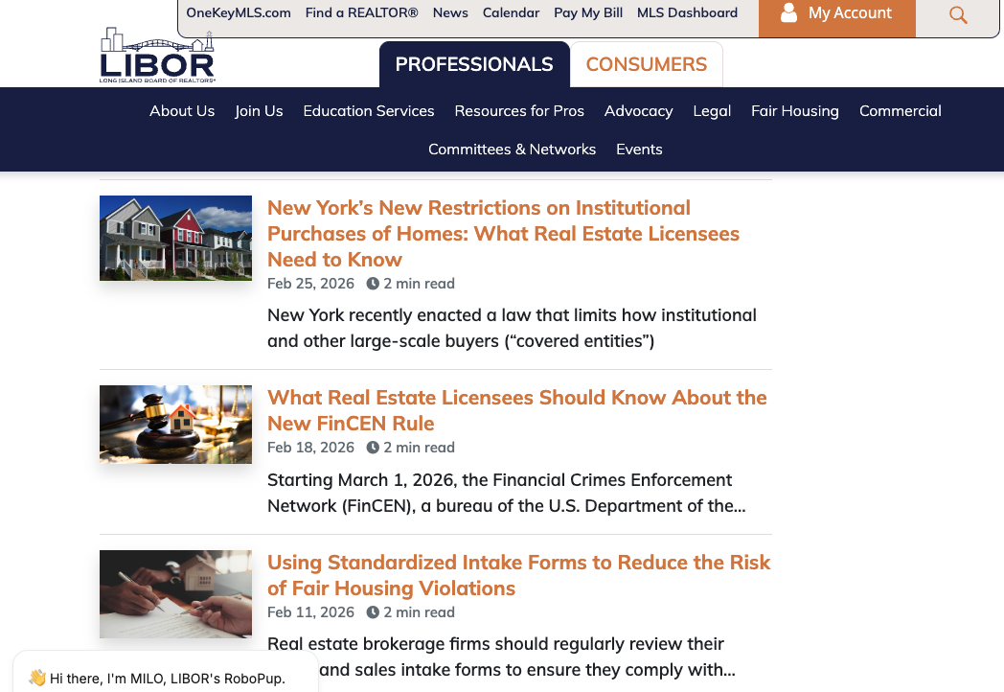
Resources & Education
LIBOR’s Website
LIRealtor.com

Slide 4
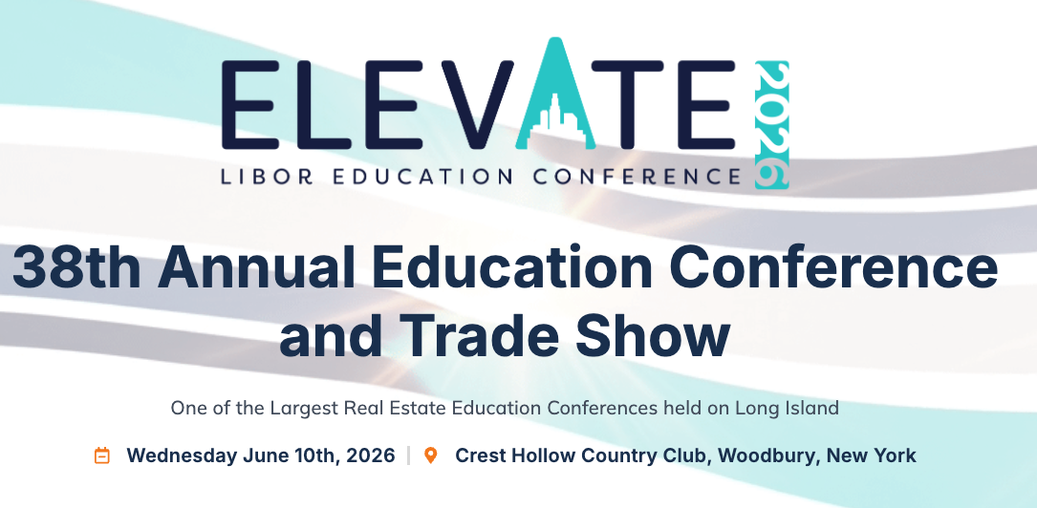
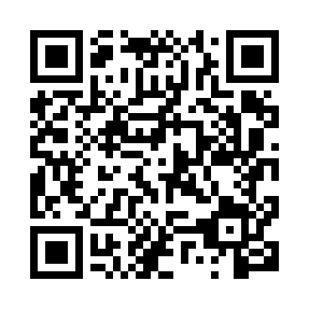
LIBOR 2026 Education Conference
liboredconference.com

Slide 5
LIRealtor.com
Access to Legal Tips
Documents on Demand with Required Disclosures & Notices
Dispute Resolution Center
Educational Materials for You and Your Clients

Slide 6
LIBOR Legal Support Center
LIBOR's Legal Support Center offers members exclusive access to a qualified attorney who can provide information on real estate matters. It is available from 9 a.m. to 5 p.m., Monday through Friday, excluding holidays.
To access, dial 631-661-4800 x335.
Notes:
Other resources from NYSAR and NAR and NYSDOS covered in handout

Slide 7

Some Recent Questions to the Legal Support Center

Slide 8
Are Cold Calls Finally Allowed?
No. General Business Law §399-z(5)(a) prohibits unsolicited telemarketing sales calls during a declared state of emergency.
EO 47.17: Public Order at Correctional Facilities (Originally declared February 19, 2025). Until at least May 24, 2026.
May be extended.
Real estate licensees may not make any unsolicited phone calls or text messages to a member of the public who they do not have an Established Business Relationship with during a State of Emergency.
All other types of marketing such as mailers, billboards, social media, internet etc., are permitted.
Notes:
An Established Business Relationship (EBR) is a voluntary two-way communication forming a relationship based on:
a purchase/transaction within 18 months, or
an inquiry/application within 3 months

Slide 9
Can My Seller Demand to See All Buyer Representation Agreements Before Looking at Offers?
No. The seller has no right to this information.
While the seller can ask, the buyer’s agent does not have to and should not provide a copy of the buyer representation agreement with their client --- it’s confidential.
It would be the same thing as a buyer asking the seller to provide a copy of their listing agreement with the listing broker.

Slide 10
If I’m Acting as a Dual Agent, Do I Need a Buyer Representation Agreement?
Yes.
Under the NAR Settlement and MLS Rules, a written buyer agreement must be signed before touring any home (in person or virtual) before any agent can work with the buyer.
You also need to have agency disclosure form and written informed consent of both the buyer and seller to act as a dual agent.
Notes:
Open house is not dual rep

Slide 11

Can a Landlord Take a Rent Application Deposit to Hold a Unit?
No — a landlord or broker cannot require or collect a “holding” or application deposit to reserve a rental unit before a lease is signed.
Under New York’s 2019 Housing Stability & Tenant Protection Act:
  Application fee: capped at $20 per applicant (for credit/background checks)
  Security deposit: up to 1 month’s rent, but only after lease signing
Those are essentially the only upfront charges permitted in typical residential rentals.
Notes:
If the tenant independently hires a broker, the tenant may lawfully pay only that broker.

Slide 12

Can a Landlord Ask a Tenant Prospect for Proof of Income?
Yes — a New York landlord can absolutely ask a prospective tenant for proof of income.
It’s a standard and legal part of tenant screening.
However, a landlord cannot:
  Reject an applicant because of lawful source of income (e.g., Section 8, SSI, child support).
  Impose different or stricter requirements based on income type.
Notes:
Risk being an invalid listing . No estate – you want Letters of Administration. Be careful with trusts…matrimonial…settlement agreements…corporate owned properties.

Slide 13
MLS Rule Changes and Ethical Obligations When Presenting Offers
Notes:
Hi everyone, I’m Patrick Fife, LIBOR's General Counsel. I want to give you a quick update on recent MLS rule changes that affect offer presentation — and what your obligations are moving forward.

Slide 14
Recent MLS Rule Change
OneKey MLS no longer mandates offer-acknowledgment process with specific time periods.
No longer a rule requiring seller to sign a specific MLS Offer Acknowledgement Form or the listing broker to provide a sworn declaration that an offer was presented
No longer a rule allowing cooperating brokers to participate in the presentation of an offer.
Notes:
OneKey® MLS recently removed former MLS Rules 405 and 406.
These rules used to govern how listing brokers documented offer presentation and whether cooperating brokers could participate in the presentation process.
The MLS no longer mandates an offer-acknowledgment process with specific time periods and no longer requires the MLS Offer Acknowledgment Form.

Slide 15
What Has NOT Changed
Members still have legal and ethical obligations under REALTOR® Code of Ethics.
Listing Broker must present all offers as quickly as possible (SOP 1-6).
Must continue presenting offers until closing unless waived in writing (SOP 1-7).
Must respond to written requests for confirmation as soon as practical.
Maintain fiduciary duties: loyalty, disclosure, obedience, reasonable care.
Notes:
Even though the MLS rules were removed, your legal and ethical duties remain the same.
Under the REALTOR® Code of Ethics:
Standard of Practice 1‑6 still requires you to present all offers as quickly as possible.
Standard of Practice 1‑7 still requires that you continue presenting offers until closing, unless the seller has waived that obligation in writing.
And when another broker sends a written request for confirmation, you must respond as soon as practical with either:
Written affirmation that you presented the offer, or
Written notice that the seller waived presentation in writing.
Your fiduciary duties — loyalty, disclosure, obedience, and reasonable care — remain fully in place.

Slide 16
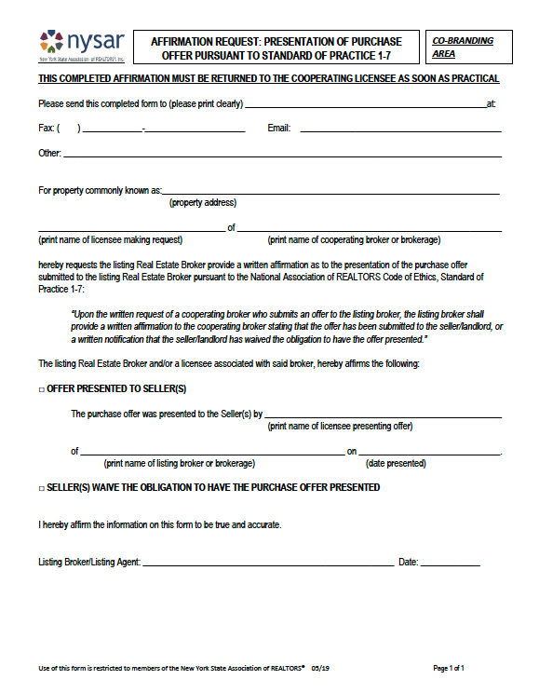
NYSAR Affirmation Request: Presentation of Purchase Offer Pursuant to Standard of Practice 1-7
Cooperating broker can use form to request listing broker’s written confirmation of offer presentation.
Listing broker must check off whether offer presented OR seller waived obligation.
Only select waiver of obligation if you possess written seller authorization.
Notes:
Although the MLS no longer mandates use of its own offer acnowledgemt form, cooperating brokers may still request written confirmation.
For that purpose, OneKey® is making available NYSAR’s Affirmation Request: Presentation of Purchase Offer, which is designed specifically to meet the requirements of Standard of Practice 1‑7.
If you receive this form as the listing broker, you must return it and check one of two boxes:
The offer was presented, or
The seller waived the obligation — but only select waiver if you have a written, signed seller waiver.
This form is optional, but it offers a sound way to ask for and provide confirmation that an offer was presented.

Slide 17
Complaint Resolution Process
The MLS no longer hears or processes complaints regarding offer presentation.
If an offer presentation issue arises, members may contact LIBOR’s Professional Standards Department to:
  Seek Ombudsman assistance through LIBOR.
  File an Ethics Complaint.
Notes:
The MLS Will not longer hear or process complaints regarding offer presentation.
If an offer presentation issue arises, you may contact LIBOR’s Professional Standards Department to:
Seek Ombudsman assistance
File an Ethics Complaint

Slide 18
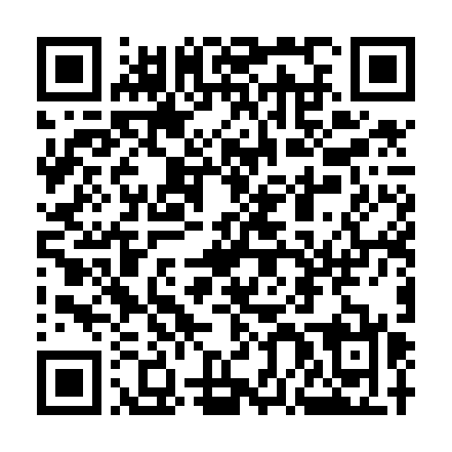
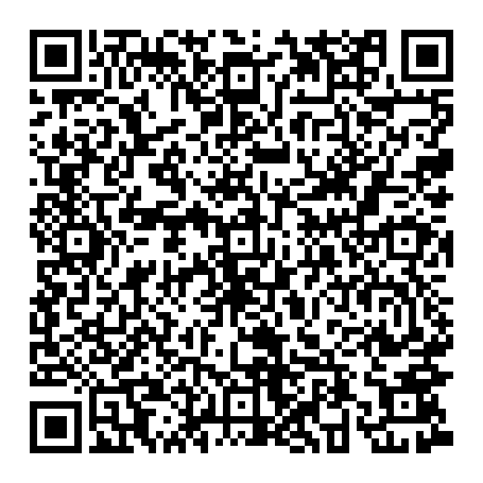
Where to Learn More
Legal Tip: 'Your Ethical Obligations When Presenting Offers’
NYSAR Affirmation Request Form
Notes:
LIBOR has prepared a detailed Legal Tip on our website, which breaks down exactly what has changed and what hasn’t.
The NYSAR form is also available on lirealtor.com.
The QR codes on the screen will take you to the legal tip and nysar affirmation form

Slide 19

Trust Has No Off Switch: Accountability 24/7

Slide 20
Can Your Conduct Outside of Your Real Estate Activity Put You at Risk?
NAR Code of Ethics & Arbitration Manual Statements of Professional Standards Policy
Effective June 5, 2025:
29. Applicability of the Code of Ethics
While REALTORS® are encouraged to follow the principles of the Code of Ethics in all of their activities, a REALTOR® shall be subject to disciplinary action under the Code of Ethics only with respect to their capacity as real estate professionals, in association with their real estate businesses, or in their real estate-related activities. (Revised and effective November 13, 2020. Additionally revised June 5, 2025.)
Notes:
2020 to 2025
A REALTOR® shall be subject to disciplinary action under the Code of Ethics with respect to all of their activities. (Revised and effective November 13, 2020)

Slide 21
NY Law Goes Further Than The REALTOR® Code of Ethics
“Off-Duty” conduct has been found by DOS and the Courts to support findings of untrustworthiness.
Fogel vs. Department of State (2d Dep’t 1994):
  “Real Property Law 441-c does not specially limit untrustworthiness to only situations where the underlying acts or conduct are related to real estate transactions.”

Slide 22

Recent Case Example: 226 DOS 25
Licensee made vulgar and racist comments in a text thread to a member of the public outside of a real estate transaction.
Salesperson’s license was suspended by DOS.
DOS said that, even through recipient of comments was not a client at the time licensee’s comments were made his comments that “does not negate his responsibilities as a Licensed real estate salesperson to act with professionalism, respect and within the bounds of the law.”

Slide 23

Recent Case Example: 256 DOS 25
Licensee directed racist and abusive epithets to health club employee that were recorded on video.
Salesperson’s license was not granted.
DOS said that “the video footage of the applicant’s display of hostility and his use of racist and abusive epithets…firmly prove his inability to treat certain members of a protected class fairly.”

Slide 24
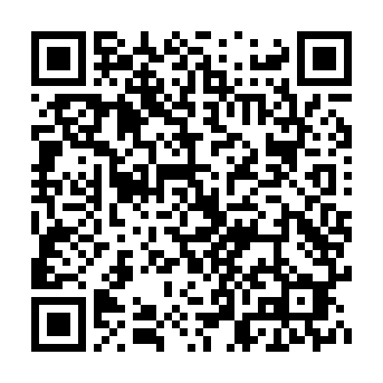
Best Practice: Follow and Promote NAR’s Pathways to Professionalism
This list of suggested professional courtesies is meant to complement the Code of Ethics
“Be aware of and respect cultural differences. Show courtesy and respect to everyone.”
“Avoid the inappropriate use of endearments or other denigrating language.”
“Real estate is a reputation business. What you do today may affect your reputation—and business—for years to come.”

Slide 25

News vs Reality – The Truth About Fair Housing Enforcement

Slide 26
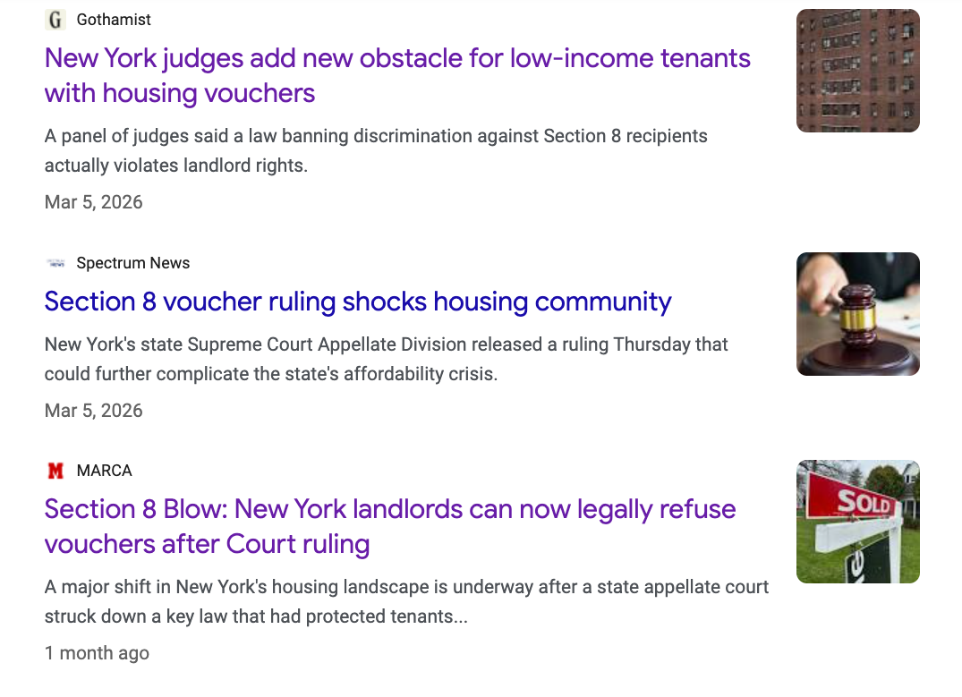
The News Says…
NY Landlords Can Refuse Section 8

Slide 27
Recent Third Department Court Ruling
In March, the New York State Supreme Court, Appellate Division (Third Department), issued a decision holding that New York’s lawful source of income protections cannot be used to require property owners to participate in the federal Section 8 program.
The court found the law unconstitutional in situations where it would force owners to consent to warrantless inspections and provide access to records.

Slide 28
REALITY… For Now, the Ruling
Does Not Change Anything!
The New York State Attorney General has appealed the decision.
In NY, when the state appeals, the ruling is automatically stayed.
As a result, all NY State and local lawful source of income protections remain fully in effect, including protections for Section 8 voucher holders.
Even if the Court of Appeals upholds the decision, it will only have a limited impact on Section 8, and program may then make an adjustment.

Slide 29

So You MUST Continue Following ALL Lawful Source of Income Laws
All lawful source of income laws remain in full force and effect.
The ruling does not pause or prevent enforcement.
Why is that important?

Slide 30

Undercover Testing Continues to Result in Violations
May 2025: Long Island agent allegedly told testers that they could not use Section 8 vouchers or Veterans Affairs Supportive Housing vouchers to pay rent.
November 2024: Baldwin apartment complex paid $20K for telling testers “we don’t participate in programs for section 8” And that “certain buildings they’ll participate in it, but we’re just not one of the one that are.”
April 2024: Suffolk County apartment complexes paid over $100,000 for allegedly telling renter a voucher would be insufficient even though it provided enough to pay the rent and saying the complex had “reached its quota” on individuals using housing subsidies.
ZERO Tolerance: DOS will seek license suspension or revocation for violations.
Notes:
Many lawsuits related to undercover testing – HRI

Slide 31
Recent December 2025
NYS DHR Case
Fair Housing Justice Center (FHJC) conducted tests where individuals posed as renters—some with employment-based income and some with income from housing vouchers.
FHJC alleged disparities in the way agents treated the testers who presented as having employment-based income versus the testers who said they had vouchers.
Agents “ghosted” or stopped responding to person once they indicated that they will cover rent using a housing voucher.
In other circumstances, listings explicitly stated that vouchers were not accepted.
Brooklyn brokerage and agents agreed to $40,000 settlement with NYSDHR.

Slide 32

What Can SOI Discrimination Look Like?
Failing to respond to inquires from voucher holders.
Making Any of the following statements:
I don’t work with voucher holders.
I don’t work with landlords who take vouchers.
Let me find out if the owner takes vouchers and get back to you.
This apartment does not take vouchers.
There is a “waitlist” for people with vouchers.
This apartment only takes Section 8 tenants with jobs.
This apartment takes section 8, but you have to pay the rent for the first month or two.

Slide 33
Have Procedures in Place to Prevent Lawful
Source of Income Discrimination
Have standard procedures for ALL prospects regardless of their source of income.
Ask the same questions you would ask any other prospective tenant:
  What area are you looking in?
  How any bedrooms are you looking for?
  What is your price range?
Don’t turn away prospects because they receive financial assistance.
When meeting prospects, tell them about all vacancies that meet their needs, regardless of their source of income.
Show voucher holders the same apartments that you would any other prospective tenant regardless of their source of income
Ask voucher holders for (1) copy of voucher, (2) name of caseworker; and (3) educate yourself to the details of the program.

Slide 34

What Should I Do if an Owner Refuses to Accept Housing Vouchers or Subsidies?
Never under any circumstances abide by a property owner’s instruction to refuse to rent to tenants seeking to pay for housing with housing assistance vouchers, subsidies, or other forms of public assistance such as Section 8.
Advise the owner that refusing to work with voucher holders is unlawful, you cannot follow their directive and stop working with that owner. Source of income discrimination must be treated like any other discrimination.

Slide 35
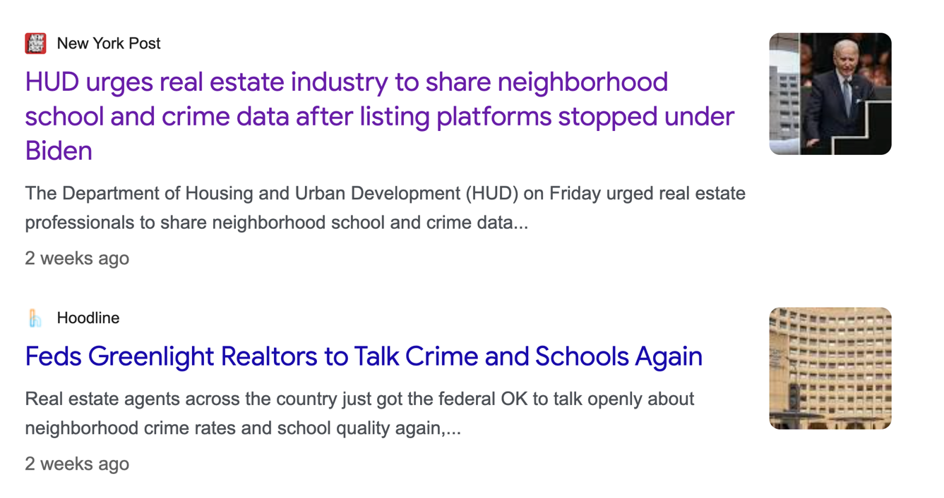
The News Says…
REALTORS® Can Talk About Crime & Schools

Slide 36
HUD’s Recent “Dear Colleague” Letter
On April 24, 2026, the U.S. Department of Housing and Urban Development (HUD) issued a “Dear Colleague” letter stating that real estate professionals may lawfully discuss neighborhood crime rates and school quality with clients without violating federal fair housing laws.
Letter could be over-read as permission to discuss crime and schools without regard to state law.
The letter signals a broader move by the administration away from enforcement based on disparate impact (where a neutral policy unintentionally affects one group more) and toward a standard of "intentional discrimination.”

Slide 37
REALITY…
New York Imposes Obligations that Exceed Federal Guidance and Risk Remains When Discussing Schools & Crime
New York State fair housing laws are separate, broader in certain respects, and remain fully enforceable regardless of HUD’s position.
Consumers should have access to accurate, complete information about neighborhood schools and crime.
Since the 1980s, NAR has encouraged providing objective, factual information about schools and crime from reliable third-party sources.
Subjective opinions, commentary, or hearsay about schools or crime may be viewed as evidence of discriminatory intent or steering in fair housing cases.
You need to continue to use caution in how these topics are discussed.

Slide 38

HUD’s Potentially Misinterpreted Quotes
“Real estate agents and brokers do not violate the Fair Housing Act merely by discussing… crime or the quality of schools.”
Risk: Can be read too broadly as a green light to freely discuss anything about these topics.
“Providing… information about school quality and crime data is not a violation when it is shared consistently without discriminatory intent.”
Risk: Doesn’t discuss what information should be provided. “Consistently” and “without discriminatory intent” are fact-intensive standards—easy to misapply in practice.
“Answering… questions about crime and schools is lawful…”
Risk: Doesn’t highlight limitations on subjective commentary or framing.
Notes:
Many lawsuits related to undercover testing – HRI

Slide 39
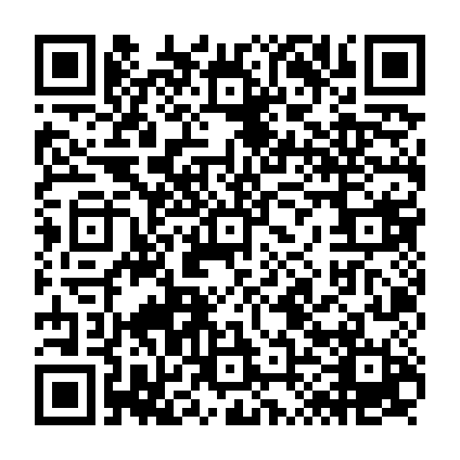
Practical Guidance for Discussing School Districts & Crime
The risk is not necessarily the topics of crime and schools.
The risk is how the information is selected, framed, and delivered such as using subjective language (“safe,” “good school,” “bad area”)
Your role is to direct clients to objective resources so they can make a decision, not to decide for them.
Agent should not interpret the information or provide their own opinions about it.
LIBOR Legal Tip: Best Practices for Handling Client Questions About Schools

Slide 40

Polished Pixels, Plain Truths: Disclosing AI in Real Estate

Slide 41
Legal Responsibilities Regarding the
Use of AI in Real Estate
DOS does not yet have a formal policy on the use of AI by licensees.
Dishonest and misleading advertisements are prohibited and could subject the real estate broker or salesperson to disciplinary action (Real Property Law § 441-c).
All advertisements must include an honest and accurate depiction of the property being sold or leased (19 NYCRR § 175.25(c)(9)).
General Business Law §§349, 350 and 350-a also prohibit deceptive acts and false advertising, and could subject any business or person engaged in the misleading advertising to substantial monetary penalties.

Slide 42
NYS Department of State November 2025 Alert on the Use of AI in Real Estate
DOS issued a warning to homebuyers and real estate professionals about a significant rise in artificially generated pictures on real estate listings.
“As the real estate market continues to evolve, this new trend is being used to enhance the marketing of a property; however, it also raises important concerns about accuracy, authenticity and the potential for false advertising.”

Slide 43

Guidance on Disclosure of Digital Enhancements
Provide both original and altered images (often side-by-side or linked).
Label AI-enhanced images as such, using clear captions like "Digitally Enhanced," "AI-Generated," or "Virtually Staged”.
Virtual staging must not misrepresent the actual condition, features or characteristics of the property.
AI-generated images must not alter the apparent demographics or characteristics of a neighborhood.
Do not use AI to generate fake photos of properties, neighborhoods or people.

Slide 44
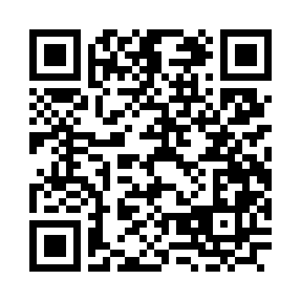
Brokers Should Consider Having an AI Use Policy For Their Office
NAR has Created an AI Policy Template for brokers that provides a starting point for establishing clear standards around the responsible use of artificial intelligence within your brokerage.
Customize it or use parts of it to reflect your company’s operations, technology platforms and policies.

Slide 45

General AI
Risk Reduction Tips
All AI-generated content should be reviewed by a human before use—including listing descriptions, marketing materials and client communications.
All brokerage-branded, client-facing or public content should be reviewed before use.
Avoid generating synthetic media (voices, images, likenesses) of brokerage staff, agents or clients without prior written approval.
Do not reproduce or modify copyrighted or trademarked materials.
Review all AI-generated content for fair housing compliance before publishing.

Slide 46

All AI Tools Are Not Created Equal
Only use AI tools approved by your office.
Use tools that agree not to train models on brokerage or client data.
Do not use an AI tool if the content cannot be preserved, governed or audited.
Don’t use personal accounts or consumer-grade AI tools (e.g., free ChatGPT) for any work involving client data or internal brokerage information.
Do not use AI for contracts or legal advice.

Slide 47

Invisible Threats: Fake Zoom Links & Vacant Land Scams

Slide 48


Legal Alert – Fake Zoom/Teams Link Scam
Targeting Long Island REALTORS®
Sophisticated phishing scam using fake Zoom, Teams, and video meeting links
Part of a growing nationwide fraud trend
Designed to access confidential business and personal information.
Scammers use real listing details to appear legitimate.

Slide 49
How the Scam Works
Scammer poses as a prospective buyer.
Asks realistic, informed questions about your listing.
Requests a quick meeting—but sends their own link.
If you click the link, you may:
  Install malware (access to email, files, passwords).
  Land on fake login pages (credential theft).
  Download “updates” that are actually malicious.
  Be recorded for future impersonation scams.

Slide 50

Red Flags to Watch Out For
New contact pushes for immediate video meeting.
Insists on using their link (not yours).
Avoids phone verification.
Claims to be out of state / unavailable locally.
Creates urgency or pressure
Prompts downloads or “updates”
Email/link looks slightly off.

Slide 51
Best Practices
Control the meeting – always send your own link.
Do not click unknown links.
Verify identity by phone first.
Never install software from a link.
Use only trusted platforms & accounts.
If You Are a Victim:
Notify broker, IT and cyber insurance immediately.
Preserve all communications.
Report to FBI IC3 (www.ic3.gov).
Alert colleagues.

Slide 52

Vacant Land Sale Scams
Continue to Rise
Growing problem on a national and local level.
According to a 2025 NAR survey, a staggering 62% of fraudulent real estate transactions involved vacant land.
The FBI reported a 500% increase in vacant land fraud cases over a recent four-year period.
Scammers are taking advantage of low inventory – hoping brokers rush into listings.
Targeting properties without mortgages.

Slide 53
What Are the Red Flags of the Scam?
Looking to list the property for significantly below market value and wants cash buyers.
Seller often claims to be out of the state or country.
Emphasizes an urgency to sell QUICKLY!
Will never communicates in person or on video, preferring to text or email.
They respond and want you to move QUICKLY!

Slide 54
The Real Consequences of a Scam
Giannone v. Silvestri
Supreme Court, Tioga County (2026)
Plaintiff claimed he owned property and never transferred title.
Sued defendant, who recorded a deed for property after paying $80K for it.
Transaction allegedly involved an unknown impersonator posing as the seller and a forged deed and notarization (linked to a compromised Texas notary stamp).
The closing proceeded even though the “seller” never appeared because the deed was pre-signed and later found to be fraudulent.
Plaintiff filed a quiet title action against the buyers.
The buyers, in turn, brought third-party claims against the broker, attorneys, and title company for fraud, negligence, unjust enrichment and breach of contract.

Slide 55
The Broker’s Defense: I Was Tricked Too!
Fraud claim allowed to proceed: Broker allegedly failed to verify that the person who listed the property with them actually owned the property.
Court held allegations were sufficient that broker ‘made a misrepresentation when they listed the property for sale.”
Broker’s claim that it lacked "actual knowledge" of the true facts is not sufficient to grant dismissal.
Was sufficient that plaintiff alleged broker should have known of the falsity of the alleged owner’s statements.
Negligence allowed to proceed: Broker owed a duty to provide accurate information about the property.

Slide 56
Possible Consequences of
Taking an Invalid Listing
Potential Legal Complications: The cost of defense alone can easily run into the tens of thousands of dollars and beyond.
Licensure Issues: It is possible DOS might find that failure to conduct due diligence as to a seller’s alleged identity constitutes incompetence.
Code of Ethics Violations: Possible violations of Article 2, 11 and 12 of the Code of Ethics.
Lost time and resources: Investment of hours to marketing, scheduling showings, and coordinating transactions for properties that cannot legally be sold or rented.
Reputational damage: Advertising or falling victim to a fraudulent property can undermine trust with clients and damage broker’s professional credibility.

Slide 57

What Can You Do To Avoid the Scam?
SLOW DOWN!!
Requires an in-person or zoom meeting (USING YOUR LINK) before taking any vacant land listing.
Require seller to provide details about the land (e.g., surrounding trees, access roads, tax bills)
Require multiple forms of identification.
Independently search the Internet for a recent picture of the seller.
Check public records to verify owner’s phone number and email.
Notes:
If you suspect that you are involved in a vacant lot scam, contact law enforcement, file a complaint at IC3.gov and quickly remove MLS Listing and all advertisements.

