Slide 1


Upcoming NY Property Condition
Disclosure Act Amendment
Patrick Fife
General Counsel

Slide 2
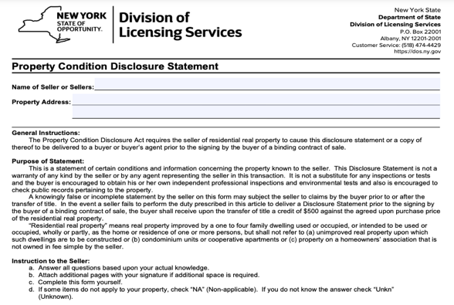
NYS Property Condition
Disclosure Act Amendment
New Flood Disclosures
Elimination of the $500
“Opt Out” Credit
Notes:
Sounds like a big deal – is it? I think it’s going to be a bigger deal for attorneys. Not so much for you
Your obligations haven’t changed. May get more questions – most of which you cannot or should not answer.

Slide 3

What is the Property Condition
Disclosure Act?
Law went into effect in 2002.
Require sellers of certain residential real property to provide a Property Condition Disclosure Statement (PCDS) to prospective purchasers detailing all known defects relating to the property.
Current law allows sellers to opt out of providing PCDS by giving a $500 credit to buyer at closing.
Notes:
Most sellers on Long Island NYC took advantage of credit.
Too many attorneys worried about litigation

Slide 4
What Are the Changes to
Property Condition Disclosure Act?
Go into effect March 20, 2024.
Property Condition Disclosure Statement (PCDS) will have new questions related to a property’s flood history.
Sellers will no longer be able to ”opt-out” with a $500 credit to the buyer at closing.
Will technically make the PCDS required on every “residential real property” transaction in New York.

Slide 5

Who Needs to Complete the PCDS?
A seller of “residential real property” must complete and deliver a PCDS to a buyer before the buyer signs a contract of sale.
“Residential real property” means real property improved by a 1 to 4 family dwellings, but does not include vacant land, condos or co-ops.

Slide 6

Are There Still Exemptions to the PCDS?
There are 14 other exemptions include:
  Bank-owned properties;
  Court-ordered sales;
  Fiduciary sales (ex. estates & trusts)
  New construction
You should not advise sellers whether a transfer qualifies for an exemption.
Sellers must speak with their attorney to determine if any exemptions apply.

Slide 7
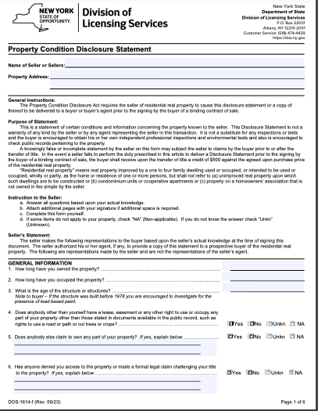
Where Can I Get the New PCDS Form?
New 7-page 56 Question form can be downloaded from the Department of State’s website.
It is also available on LIBOR’s Documents on Demand page.
DO NOT BEGIN USING THE NEW FORM UNTIL March 20, 2024.
Notes:
READ THE FORM!! Lots of good info in there.

Slide 8
What Are My
Obligations Regarding the PCDS?
They have not changed.
Listing agent has duty to provide the PCDS and timely inform each seller that a signed PCDS must be delivered to buyer or buyer’s agent prior to buyer signing binding contract of sale; and a copy of the PDCS containing seller’s and buyer’s signatures must be attached to the contract.
Buyer’s agent or seller’s agent dealing with a prospective buyer as customer has the duty to timely (before the buyer signs a binding contract of sale) inform the buyer of the buyer’s rights and obligations under the law.
Notes:
THEY HAVE NOT CHANGED

Slide 9
What Happens if I Fulfill My Obligations?
Good News!
The laws says “the agent shall have no further duties under this article and shall not be liable to any party for a violation of this article.”

Slide 10

There Are Really Only Two Differences on March 20th
You need to provide sellers the new PCDS form.
You can no longer advise sellers they have the option of providing a $500 credit to buyers at closing in lieu of delivering a completed PCDS.

Slide 11

What Does This Mean for Listings that Are Under Contract as of March 20th?
For all of your listings where a contract of sale was entered into by your clients and their buyers prior to March 20, 2024, the Property Condition Disclosure Act amendments will not be applicable.
Those sellers do not have to provide a PCDS and can still avail themselves of the $500 credit.

Slide 12
What About Active Listings that Aren’t Under Contract as of March 20th?
If you have active listings where your clients have not yet entered into a contract of sale with a buyer as of March 20, 2024, you should provide your clients with the new PCDS form and inform them they can no longer avail themselves of the $500 credit option in lieu of PCDS.

Slide 13

When Should I Provide the PCDS to the Seller?
It is strongly recommended that you provide a copy of the PCDS to the seller at the time the listing agreement is signed.
The PCDS may be provided electronically or by hard copy.

Slide 14
Best Practices for PCDS Delivery
You will want to document that you delivered the PCDS to the seller and that you informed sellers and buyers of their rights and obligations under the law.
You should strongly recommend to buyer and seller clients that they discuss the ramifications and requirements of the PCDS with their attorneys.

Slide 15
How Can I Document that I Fulfilled My Obligations?
Get some type of written acknowledgement from the seller that you informed the seller of their obligations.
Updated One Key Exclusive Right to Sell Agreement (para 17) and updated Property Condition Buyer’s Rights & Seller’s Obligations form
Both are available on Documents on Demand.
Do not use updated forms until March 20, 2024. They are labeled (Effective Starting 3/20/24 – DO NOT USE BEFORE).

Slide 16

OneKey Exclusive Right to Sell Agreement
17. As the owner of residential real property, OWNER must complete and sign a Property Condition Disclosure Statement as required by Real Property Law §462(2) and cause it, or a copy thereof, to be delivered to a buyer or buyer’s agent prior to the signing by the buyer of a binding contract of sale. A copy of the Property Condition Disclosure Statement containing the signatures of both the buyer and the OWNER must be attached to the real estate purchase contract. If OWNER acquires knowledge which renders materially inaccurate a Property Condition Disclosure Statement previously provided, OWNER must deliver a revised Property Condition Disclosure Statement to the buyer as soon as practicable. In no event, however, will OWNER be required to provide a revised Property Condition Disclosure Statement after the transfer of title from OWNER to the buyer or after the buyer has commenced occupancy of the PROPERTY. OWNER should seek the advice of their attorney regarding the filling out and exchange of the Property Condition Disclosure Statement or any questions as to OWNER’s obligations under the law.

Slide 17

Should I Help the Seller Fill Out the PCDS?
No. The PCDS specifically directs sellers to “Complete this form yourself.”
The seller must answer “yes,” “no,” “not applicable,” or “unknown” based upon the seller’s actual knowledge at the time of signing.
Recommend clients seek the advice of their attorney regarding the filling out and exchange of the PCDS or questions as to their rights and obligations under the law.

Slide 18

Does the PCDS Form Need to Be Uploaded to the MLS?
No. The completed PCDS does not need to be uploaded to the MLS. The listing agent is not even required to take possession of the PCDS.
If you are going to upload the PCDS to the MLS, you should only do so with the seller’s consent.

Slide 19

Who Has Responsibility for Delivering the PCDS to the Buyer or Buyer’s Agent?
The seller is ultimately responsible for delivery of the PCDS.
You should recommend that sellers speak with their attorney about when delivery of the PCDS will be made.
You are only responsible for delivering the PCDS to the buyer or buyer’s agent if you assume or accept the responsibility on behalf of the seller. Make it clear to the seller if you are assuming the responsibility.
Notes:
Seller can deliver PCDS to buyer at any time as long as it’s prior to delivery of signed contract

Slide 20

Do I Need to Keep a Copy of the Fully Signed PCDS in My File for Record Keeping Purposes?
There is no requirement that a licensee take possession of or keep copies of the PCDS.
However, as a best practice, if you accept responsibility for providing a copy of the PCDS to a buyer or buyer’s agent, you should retain a copy of the completed PCDS for your records.

Slide 21

What Should I Do if My Client Has Questions About the PCDS?
Recommend that clients seek the advice of their attorney regarding the filling out and exchange of the PCDS or questions as to their rights and obligations under the law.

Slide 22

What Happens if the Seller Fails to Provide the PCDS?
We don’t know yet.
Never advise sellers whether they should or should not fill out the PCDS.
Sellers who do not want to provide the PCDS should only do so under the advice of their attorney.
Buyers who do not receive a PCDS from the seller should speak with their attorney.
Notes:
Probably will get resolved through litigation or legislation amendment.

Slide 23

Should the PCDS Take the Place of a Home Inspection or Other Testing?
Absolutely not.
The PCDS itself states “It is not a substitute for any inspections or tests and the buyer is encouraged to obtain his or her own independent professional inspections and environmental tests and also is encouraged to check public records pertaining to the property.”

Slide 24
Does the PCDS Constitute a Warranty?
No. The PCDS itself states “this Disclosure Statement is not a warranty of any kind by the seller or by any agent representing the seller in this transaction.”

Slide 25
Where Can I Learn More?
Review our PCDS legal tip at LIRealtor.com/legal
FAQ regarding PCDS is available at LIRealtor.com/pcdsFAQ
Call NYSAR Legal Helpline Monday-Friday from 9:00am-4:00pm at 518-436-9727.

