Slide 1

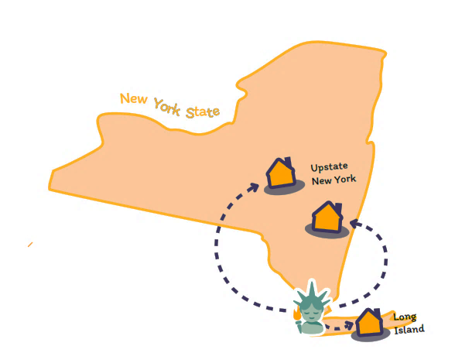
Statewide CityFHEPS

Slide 2
Department of Social Services
Human Resources Administration (HRA)
Department of Social Services (DSS)
Department of Homeless Services (DHS)
HRA is the nation's largest social services agency and assists over three million low‐income and vulnerable New Yorkers annually through the effective and efficient administration of more than 12 major public benefits programs.
DHS works to prevent homelessness, addresses sheltered and unsheltered homelessness, and assists New Yorkers experiencing homelessness transition to permanent housing.
Streamlining Access to Social Services | Addressing Homelessness and Housing Instability | Creating Economic Stability

Slide 3
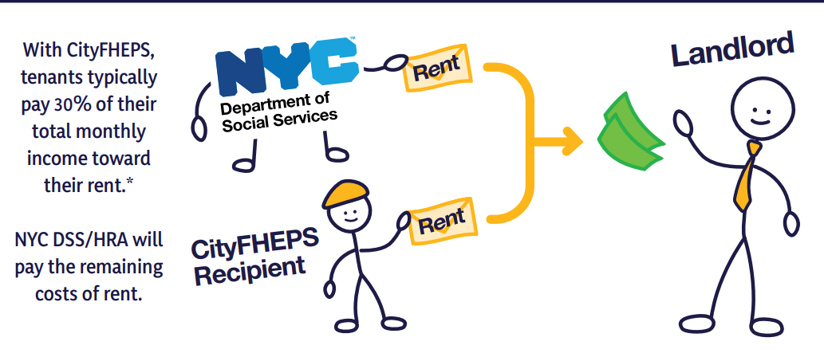
Background
Monthly ‘supplement” payment from NYC DSS to cover a portion of the tenant’s rent
01
Receive the first three (3) months’ rent supplement up front
02
Monthly rental assistance payments from DSS for up to five (5) years
03
Statewide CityFHEPS (the City Fighting Homelessness and Eviction Prevention Supplement) is a rental assistance program that helps individuals and families living on low incomes search and pay for housing anywhere in New York State.
*If tenants are eligible for cash assistance, landlords may also get a portion of rent paid with shelter allowance.
Benefits

Slide 4
Shopping Letter
Finds Apartment
Walk-through
Landlord Package
Package Review
Key Exchange
Lease Up Flow

Slide 5
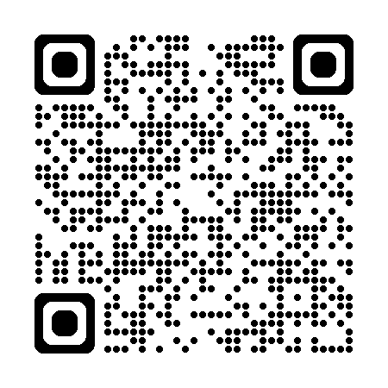
Shopping letter
Establishes that a client might be eligible for CityFHEPS and allows them to start looking for housing.
Direct landlords and brokers to, www.nyc.gov/dsshousing, where more information about financial incentives they may be eligible to receive can be obtained
List of documents needed from the landlord or broker to continue the CityFHEPS eligibility assessment

Slide 6

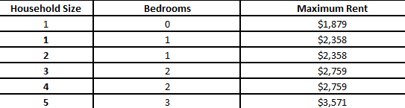
Rental Amounts
CityFHEPS rents outside of NYC are set to the local county standard.
Nassau and Suffolk*
*Maximum rent is $7,359 for a household size of 20 living in 10-bedrooms. Statewide CityFHEPS Maximum Rents by County Tool
Owners can sign up for Electronic Funds Transfer (EFT) and see payments online.
Payments

Slide 7
DHS or provider staff conduct walk-throughs utilizing a comprehensive apartment review checklist
01
In-person for all units in Nassau, Rockland, Suffolk, or Westchester
02
Virtual walk-through for apartments in all other counties
03
No-preclearance process for apartments outside of NYC
04
Ensures condition of the rental unit and building meet basic health and safety requirements.
Walk-through

Slide 8
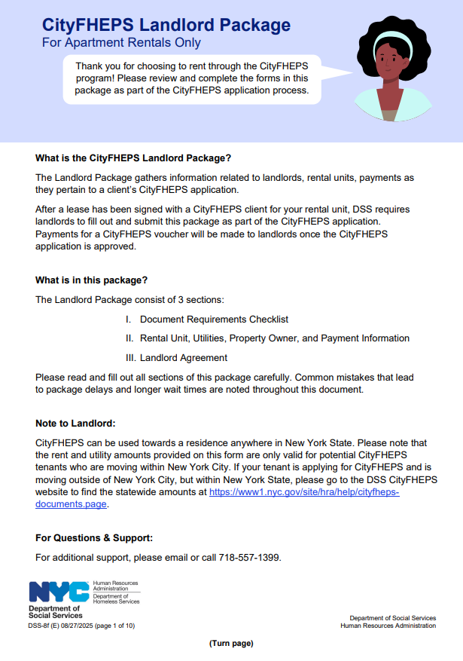

Landlord Package
Gathers landlord, rental unit, and payment information
Completed after a lease has been signed with a client
The Landlord Package consists of 3 sections:
I. Document Requirements Checklist
II. Rental Unit, Utilities, Property Owner, and Payment Information
III. Landlord Agreement
Important Tips
  Fill out the Landlord / Owner’s name exactly as written on the deed, including instances of “Inc.” or “LLC”
  Double check the broker’s name is entered correctly and ensure page 6 is completed

Slide 9
Package Review
Property ownership check preformed
Review package to verify and ensure information aligns with details and documents provided by landlord and client, and checks conducted by DSS
Rent reasonableness

Slide 10
Key Exchange
Happens after the CityFHEPS application is approved
Tenant is provided keys to the unit that was shown and approved
Rental assistance checks are given to the landlord and/or broker

Slide 11
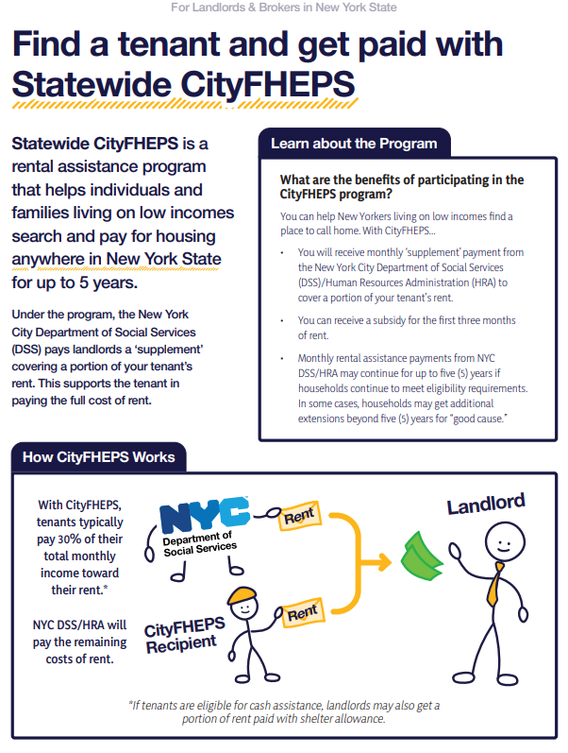
Next Steps
Call the Public Engagement Unit’s Home Support Unit at 212-331-6240 to participate in the program.
Share the landlord flyer with individuals and organizations that may be interested in the program.
Partner with us to raise awareness about the program in Long Island.

Slide 12

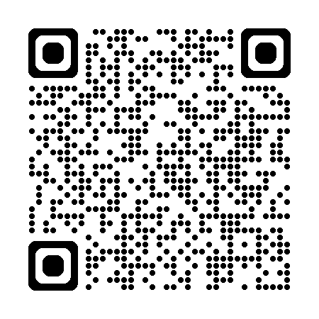
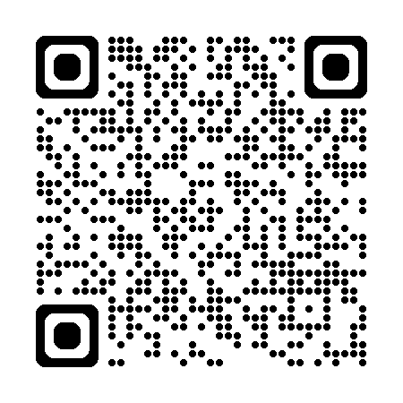
Learn More
Public Engagement Unit
Statewide
CityFHEPS
Call the Public Engagement Unit’s Home Support Unit: 212-331-6240

Slide 13

Questions & Comments

